Slide 1
Green hero forest fire
Iris Bobeta
Maria Strejček

Slide 2
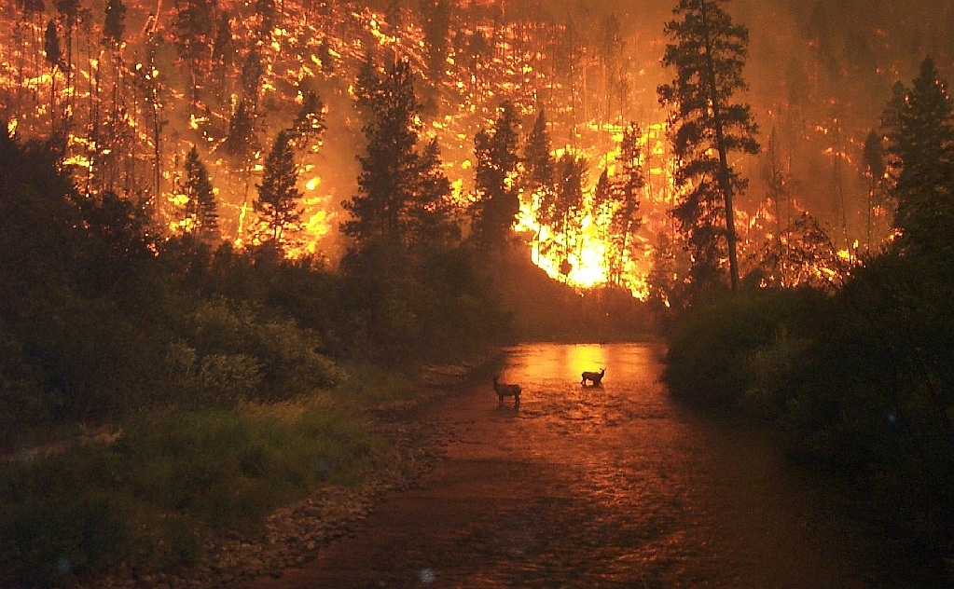
Fire is common in Mediterranean countries because of heat and wind that blows
They cause a great material damage and endanger lives of people and animals

Slide 3
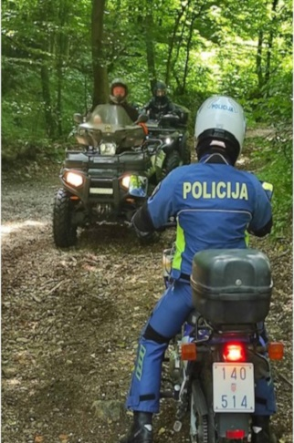
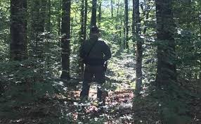
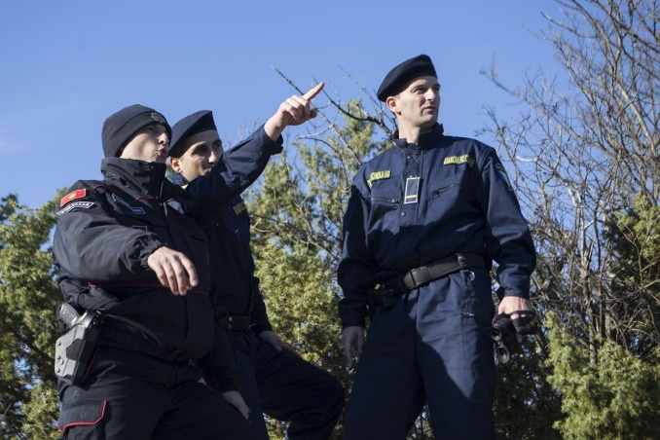
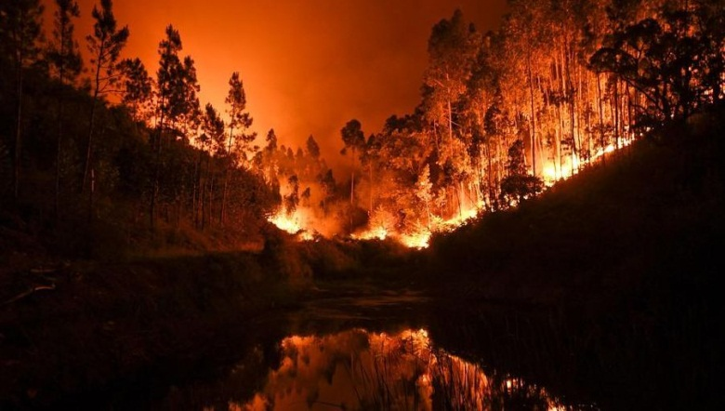
How to protect forest from fire?
guardians should be introduced to oversee forest areas

Slide 4
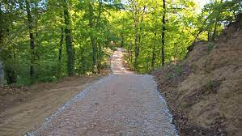
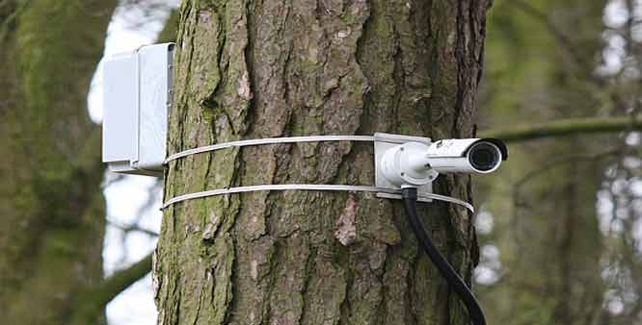
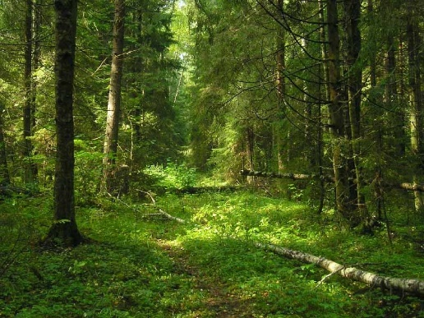
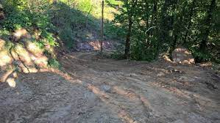
maintain forest roads
make video surveillance

Slide 5
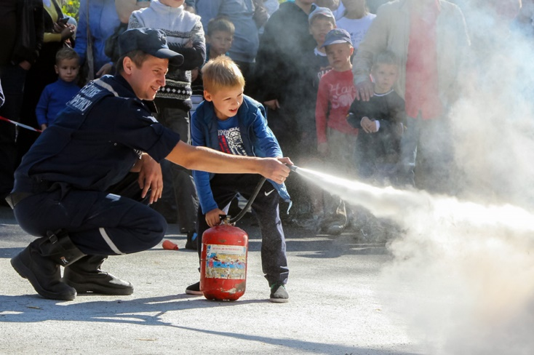
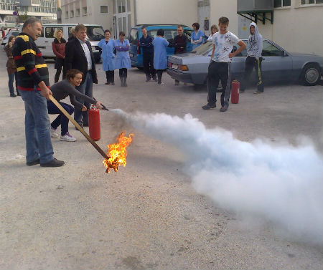
maintain special education for children and adults

Slide 6
let's protect nature we can't buy a new one

