Slide 1
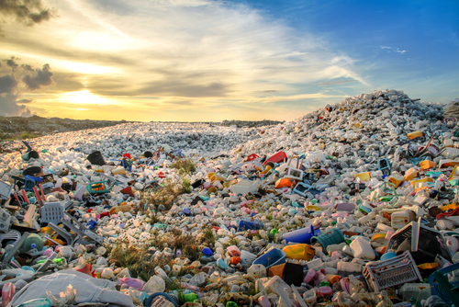
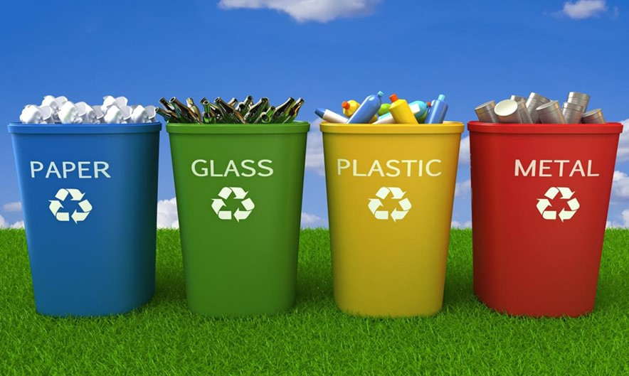
WASTE AND RECYCLING
By: Marino and Ivano

Slide 2
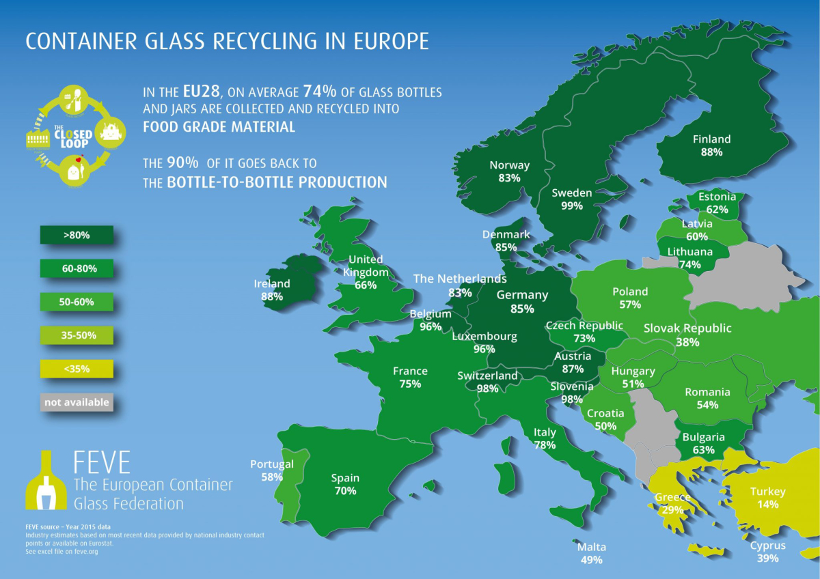
How much waste is produced in Croatia
The Croat produces 416 kilograms of waste.
Croatia recycles slightly less than a quarter (24%) of the generated waste per citizen (98 kg out of 416 kg).
Denmark, Norway and Switzerland produce almost twice as much waste as Croatia, but they recycle a lot more.

Slide 3
How waste is disposed of in Croatia
In the list of countries that recycled the most household waste in the period from 2010. to 2019., ranked by the European Environment Agency (using official Eurostat data), Croatia ranked 2nd in the rate of recycling of household waste.
Croatia increased by 655% the rate of recycling household waste between 2010. and 2019.
Its recycling rate in 2019. was 30.2%, compared to only 10% in 2010.
in 2020., Croatia continued reducing the amount of municipal waste, increasing rates of separation of household waste and recycling.
Today it is working effectively to eliminate unnecessary waste in landfills, save energy and natural resources, and prevent air pollution.

Slide 4
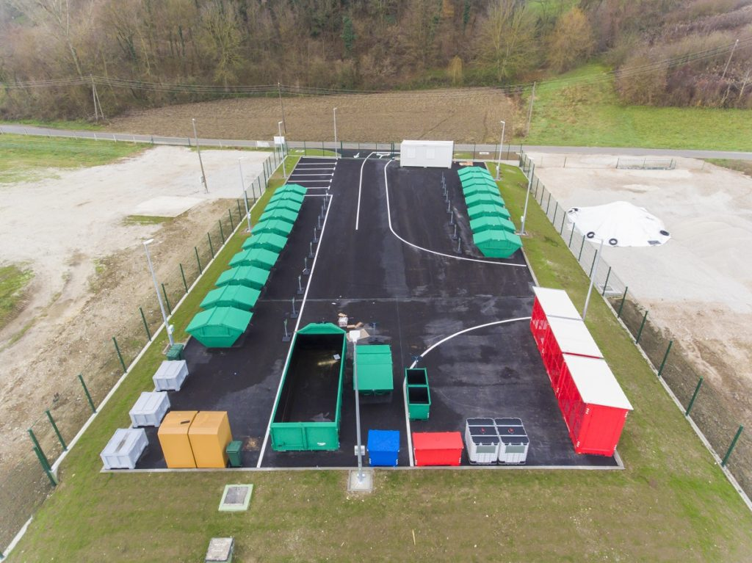
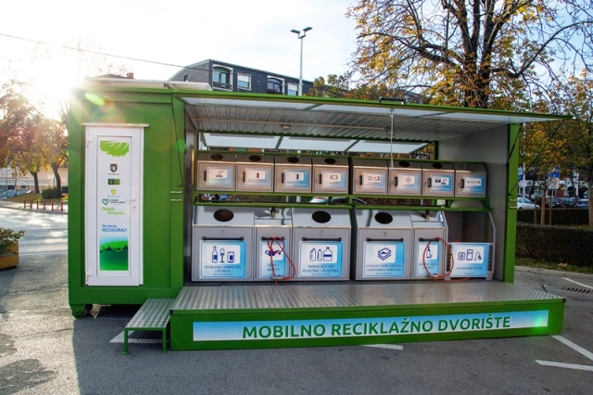
Recycling yards
Recycling yard is a controlled fenced area intended for separate collection and temporary storage of small quantities of special types of waste.
List of waste that can be disposed of in recycling yards: paper, cardboard, plastic, metal packaging, old batteries, glass packaging waste, PET - bottles, cans, old medicines, electronic waste, wood waste, textile, green waste, etc.
In Croatia every city should have at least one Recycling yard.

Slide 5
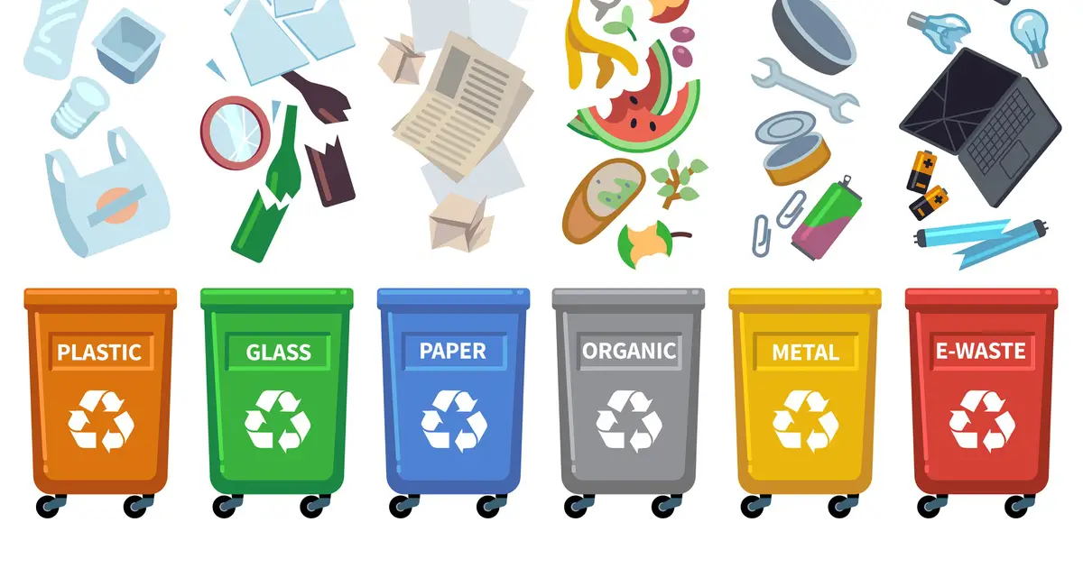
How can we reduce the amount of waste
Dispose of useful waste in the ECO-ISLANDS free of charge:
- Dispose of waste paper in a blue container
- Dispose of waste glass in a green container
- Dispose of PET packaging in a yellow container
- Dispose of old batteries in a red container
When you go shopping bring your own bag
Buy drinks in returnable bottles
If possible, buy larger quantities (packages),
not individually
Whatever can be fixed, fix it and use it again

