Slide 1
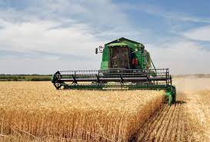
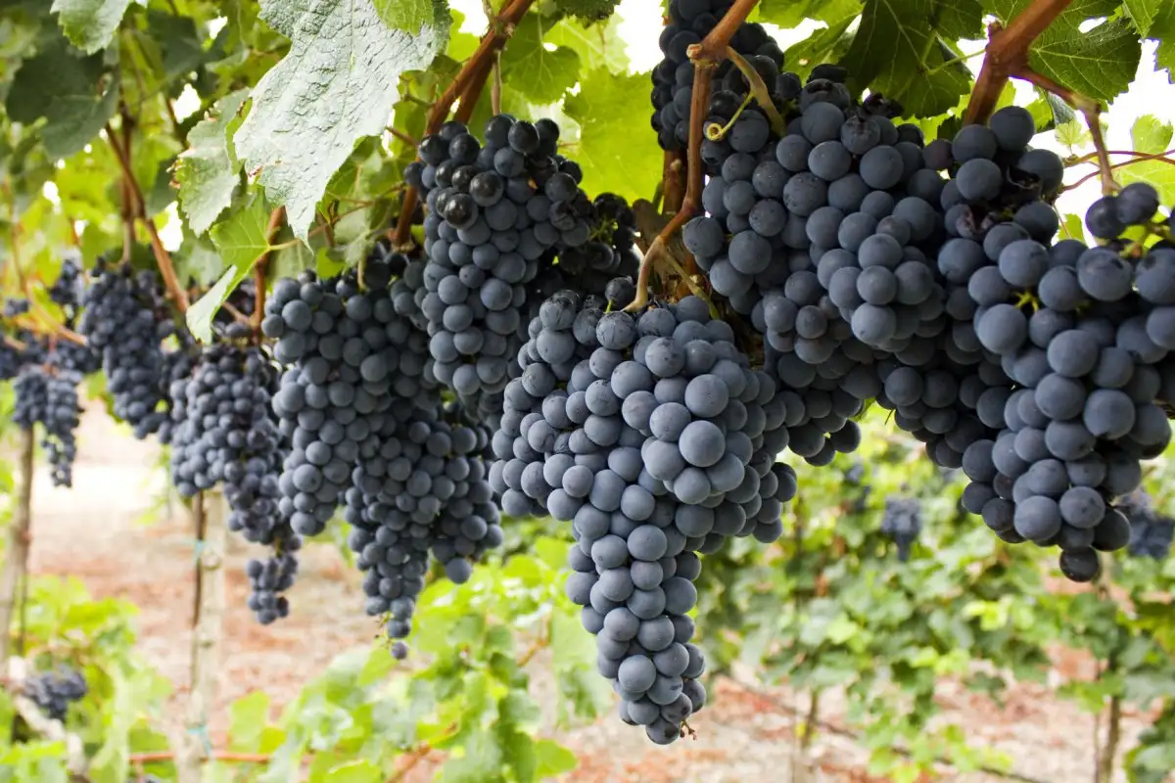
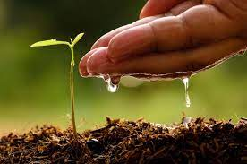
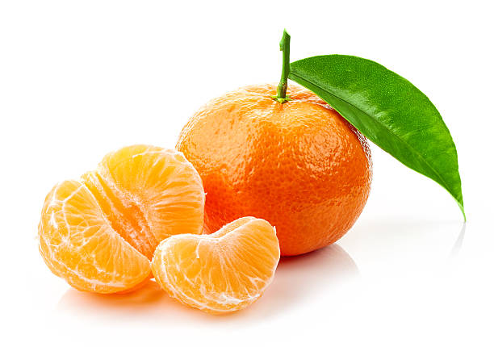
AGRICULTURE IN CROATIA
By Borna Turkalj, Leona Lučić
and Vedran Lončarević

Slide 2
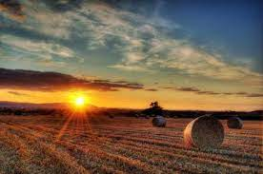
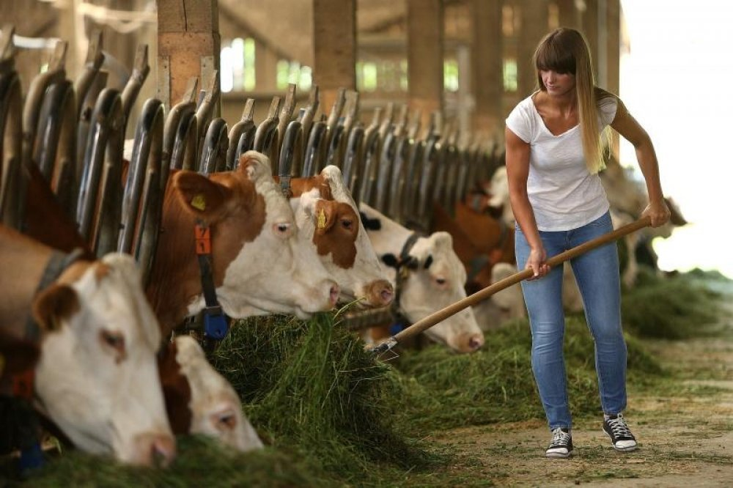
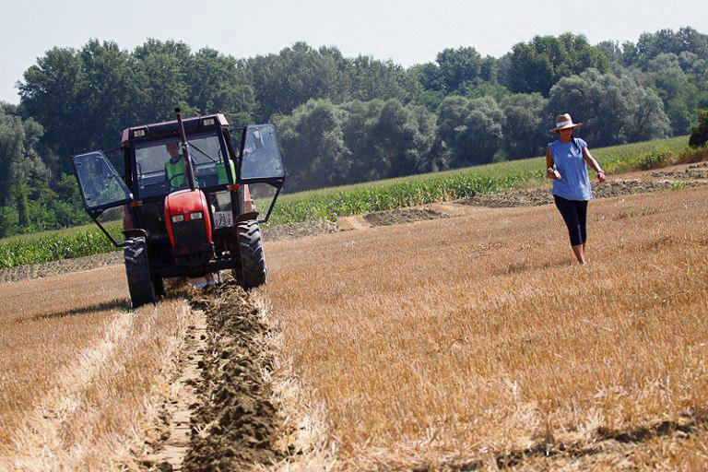
FARMERS
Around 1 390 000 people in Croatia are working in agriculture
Regions that make the most products are Slavonia (corn and wheat), Istria & Dalmatia (olives and grapes) and Neretva valley (tangerines)

Slide 3
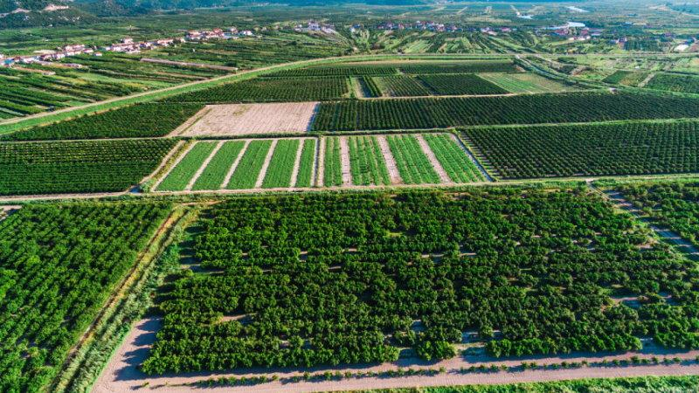
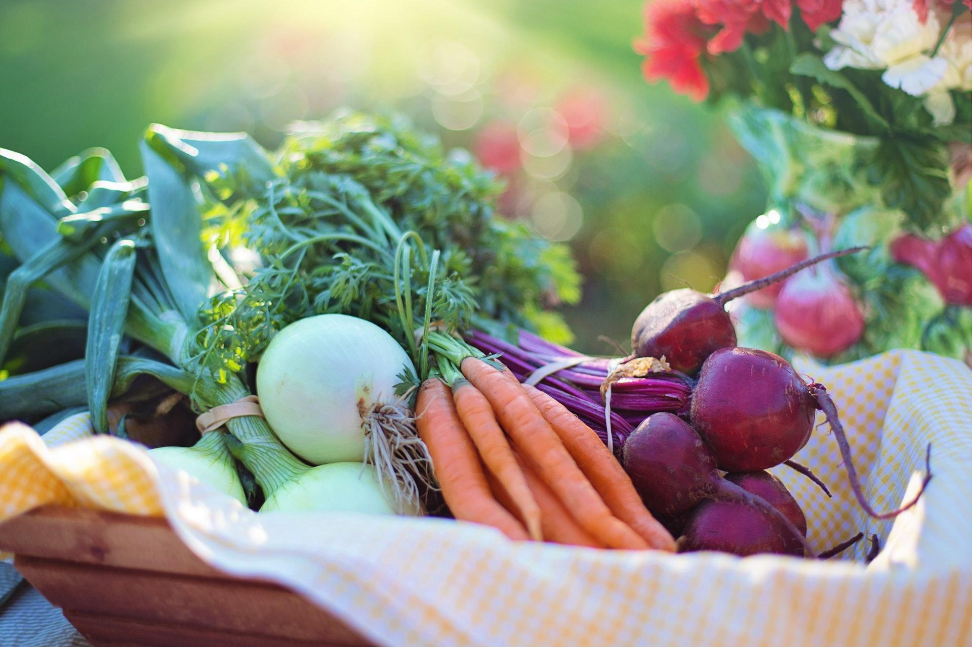
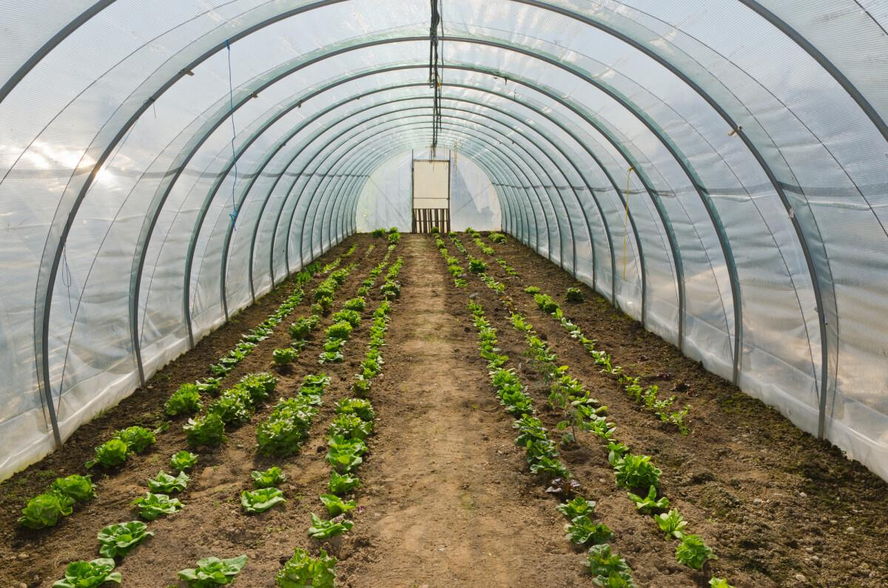
ORGANIC AGRICULTURE
Organic production is a comprehensive system of farm and food production management that combines best practice in terms of environment and climate
Around 5 550 people are in organic agriculture and 7% of all fields in Croatia are used for organic farming.

Slide 4
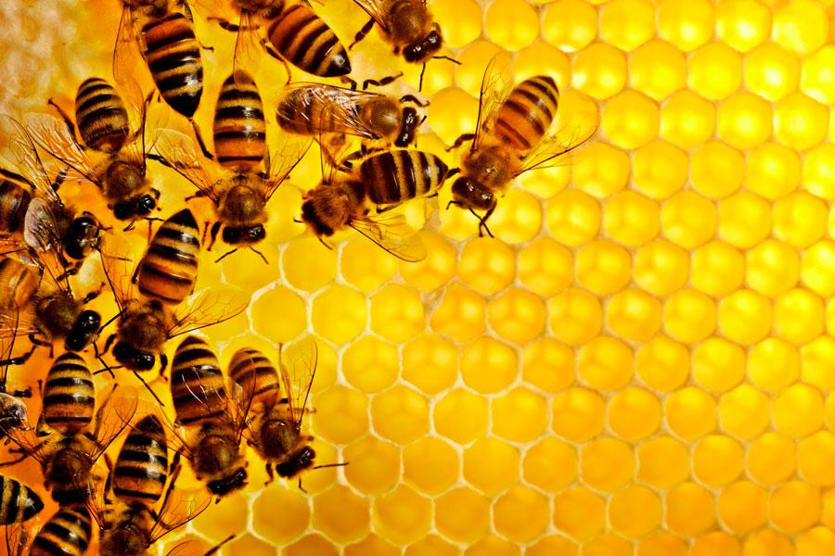
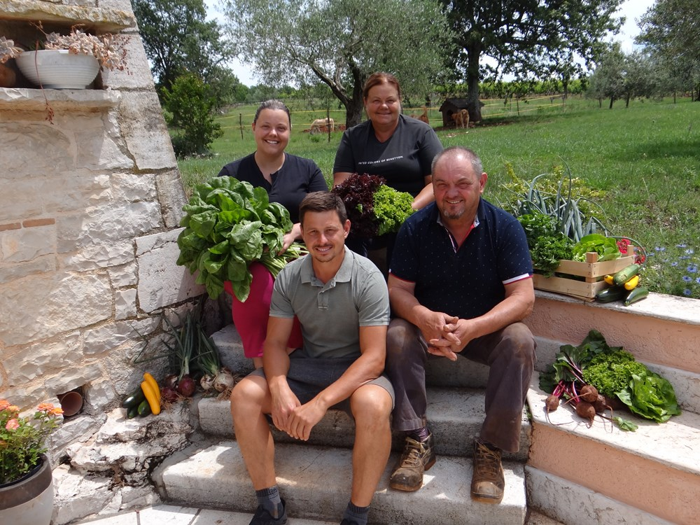
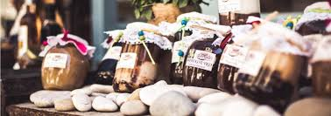
OPG - Obiteljsko poljoprivredno gospodarstvo
Family farm is an organizational form of an economic entity of a natural person farmer who, in order to generate income, independently and permanently performs the activity of agriculture and related ancillary activities.
150 000 OPG in Croatia

Slide 5
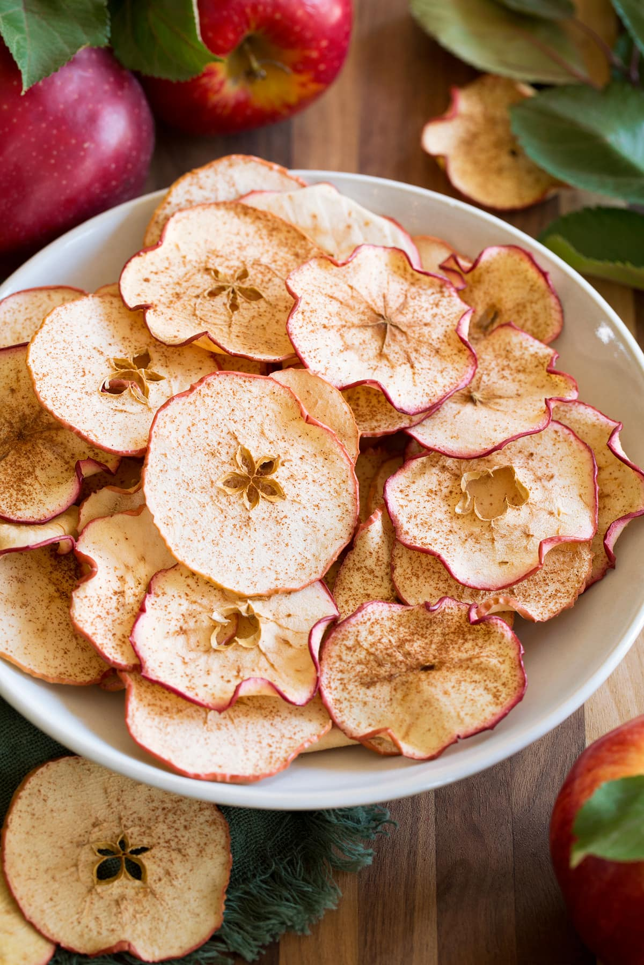
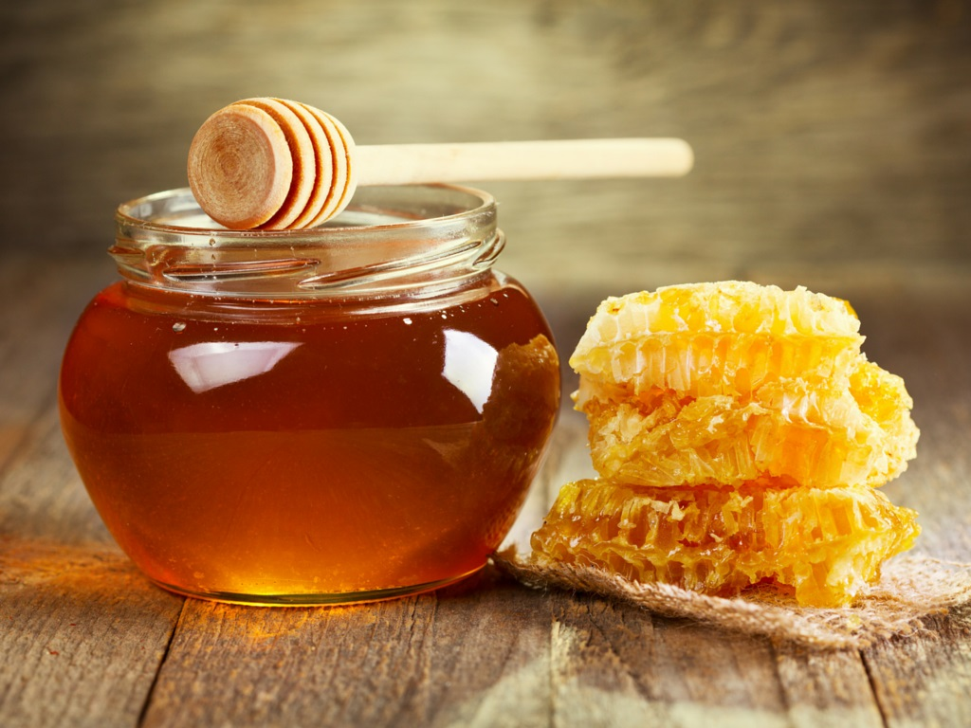
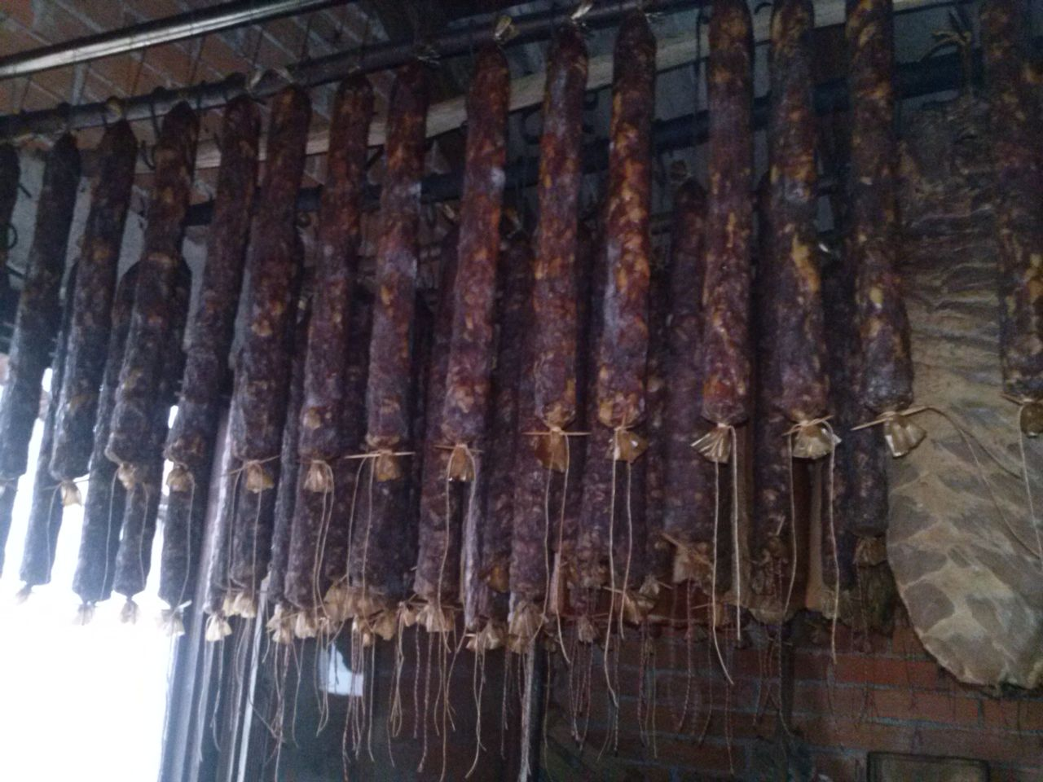
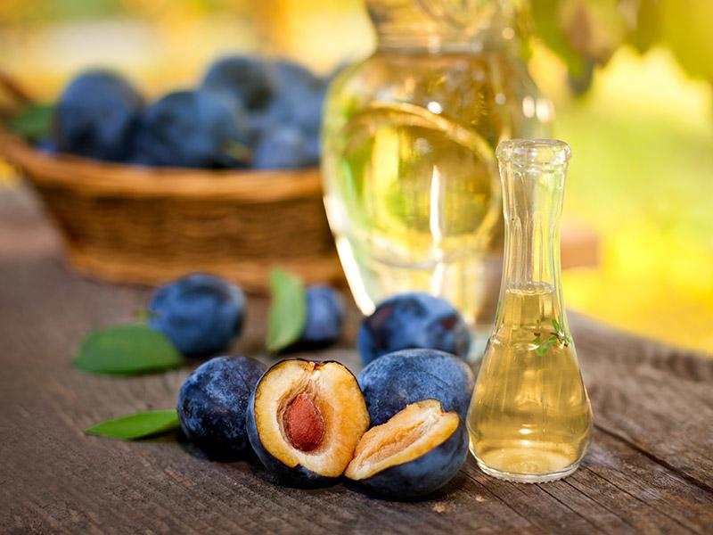
BANOVINA
Agriculture in our region refers to livestock and farming
In our region people cultivate fruits (plums, apples, berries)
The most popular products from our region are: rakija, apple chips, blackberry wine, honey, saussages and other pork products

