Slide 1
Deforestation ili uništavanje šuma Veronika Majstorović & Andrej Šeperac

Slide 2
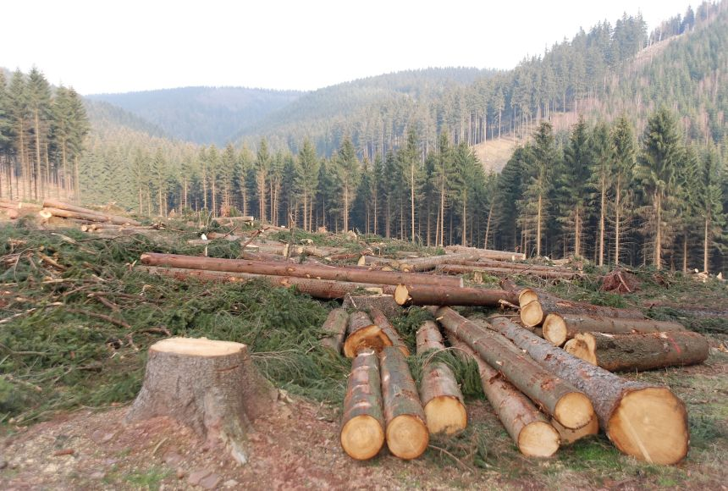
What is that?
Deforestation is a worldwide problem where people are destroying forests, jungles and etc.

Slide 3
Why are we cutting so many trees?
the biggest driver of deforestation is agriculture. Farmers cut forests to provide more room for planting crops or grazing livestock
building houses and furniture
make space for more people that are looking for a new place to live
to make paper
for heating purposes
etc.

Slide 4
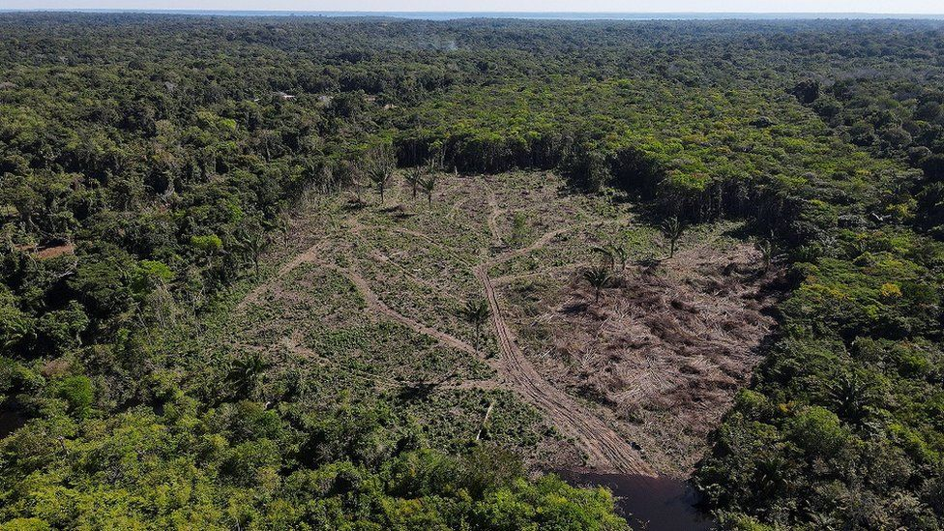
Deforestation in the world
We losing up to 80,000 acres of tropical rainforests daily!.
In the last 50 years, Brazil's Amazon has lost about a fifth (1/5) of its forest cover—almost 300,000 square miles!

Slide 5
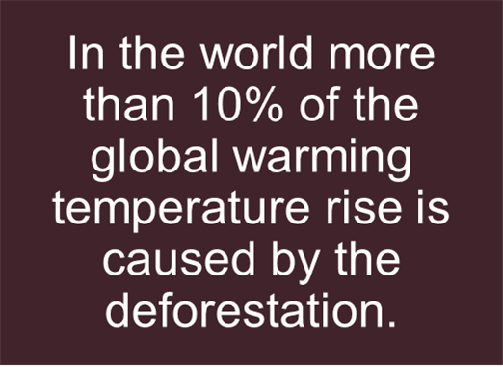
What are the consequences?
flooding
desertification
fewer crops
reduction of oxygen

Slide 6
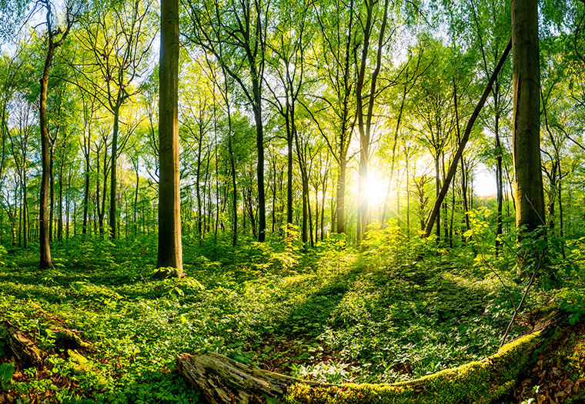
Deforestation in Croatia
Croatia is in a big problem due to deforestation, we have forests in all of our parts of the country
here in Banovina highest paid job is the lumberjack
More than 21% of Croatia’s
forest was destroyed!

Slide 7
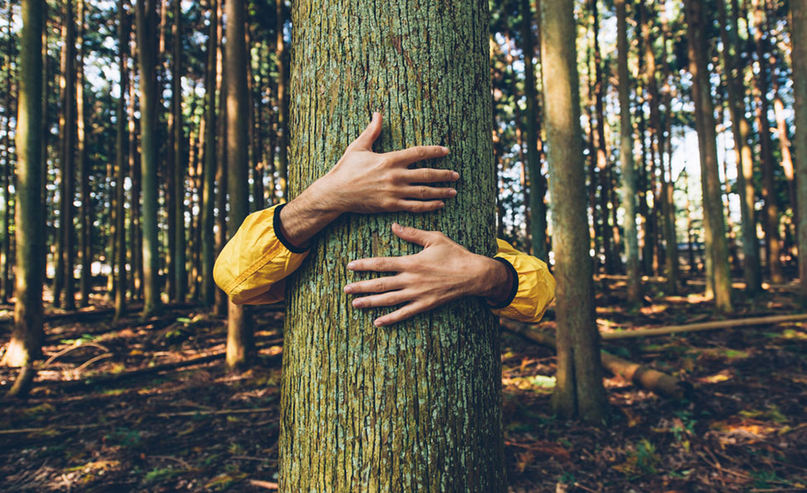
Can we prevent deforestation?
unfortunetly we have no power and rights to prevent it but we can grow the lost back, in the world there are more than 5000 organisations that want to restore the life to the planet
you can join them using your mobile devices and maybe if you want to start your own one day

Slide 8
THANK YOU!
We appriciate your time

