Slide 1
Air pollution
Primary school Glina, Glina, Croatia
Lili, Klea Luana, Mia, Lea

Slide 2
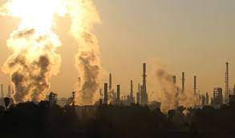
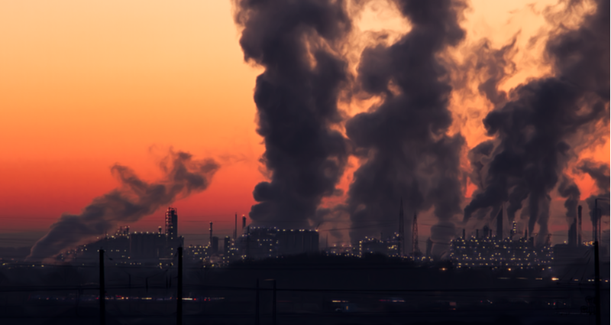
WHAT IS AIR POLLUTION?
Air pollution is contamination of the environment by chemicals.
HOW DOES AIR POLLUTION OCCUR?
Air pollution is caused by solid and liquid particles and certain gases that are suspended in the air.

Slide 3
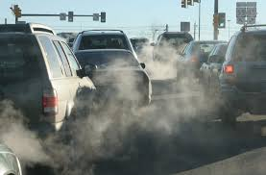
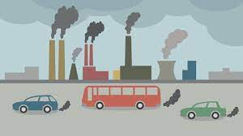
WHO HAS THE MOST INFLUENCE ON AIR POLLUTION?
-Cars, factories, buses, planes and more.
WHERE IS AIR MOST POLLUTED?
-The most polluted place on Earth is India.

Slide 4
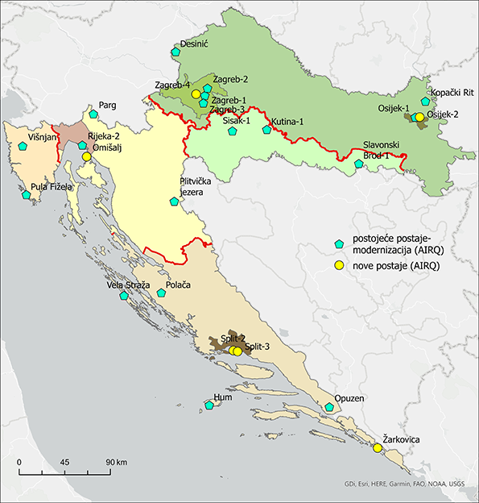
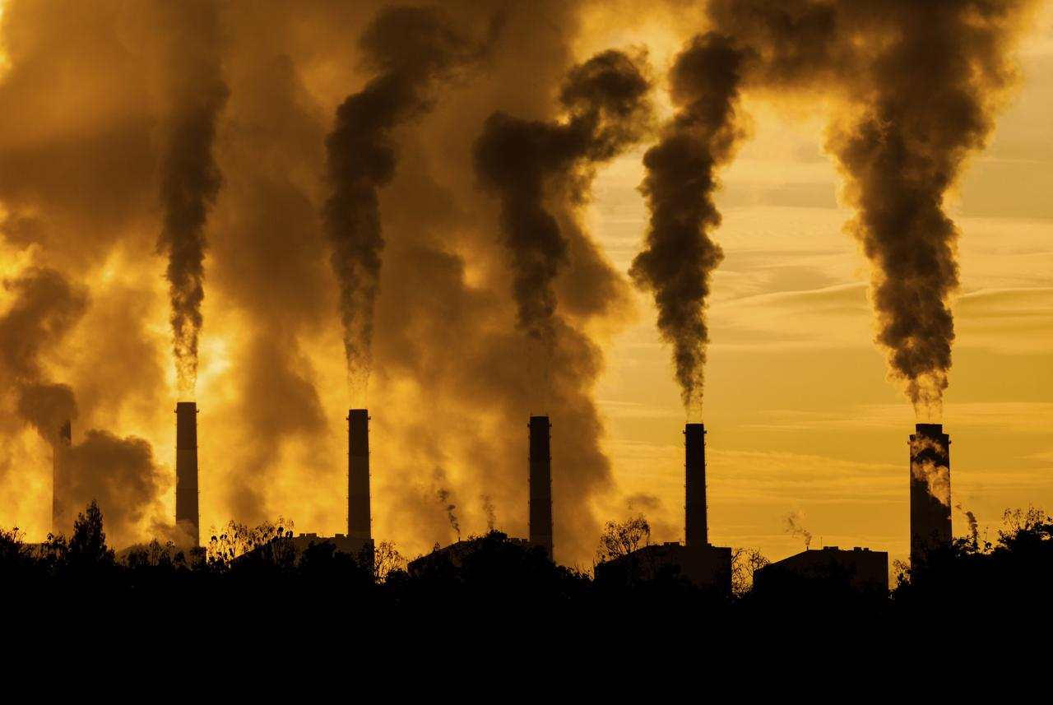
Air pollution in Croatia
Who is in charge of air quality control?
-the Ministry of Environmental Protection
How many measuring stations are there?
-there are 6 measuring stations
Where is the worst air quality?
-in Zagreb

Slide 5
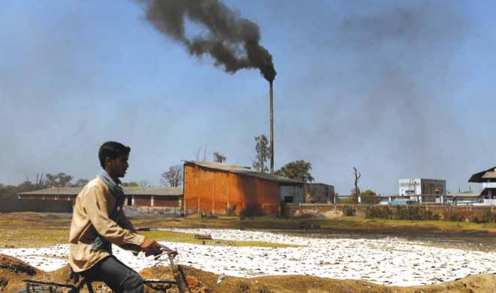
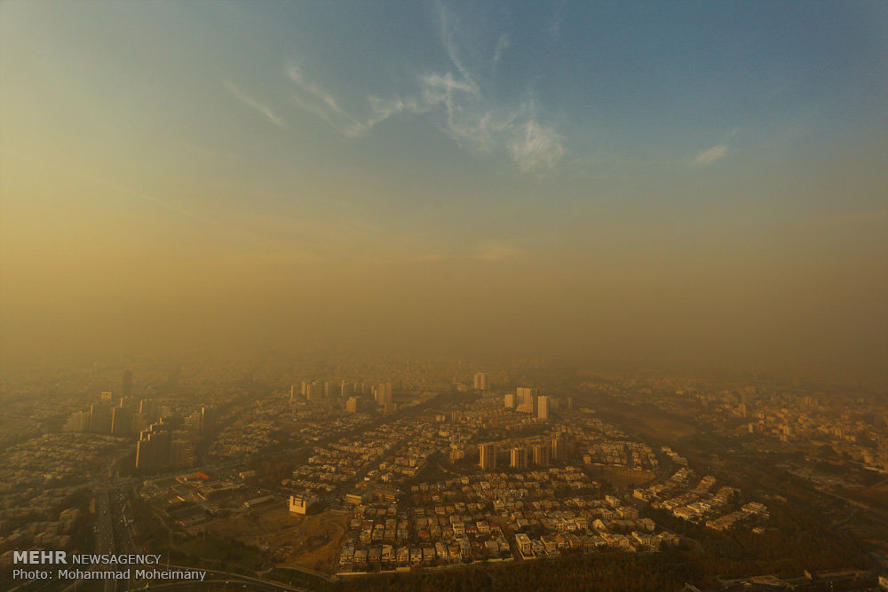
Air pollution in Croatia
Air quality data for Sisak-Moslavina county in the last month
It is satisfactory, however, some pollutants may pose a moderate health hazard to a very small number of people who are unusually sensitive to air pollution.
In conclusion the air quality is moderate but if it was cleaner it could be better for the environment.

