Slide 1
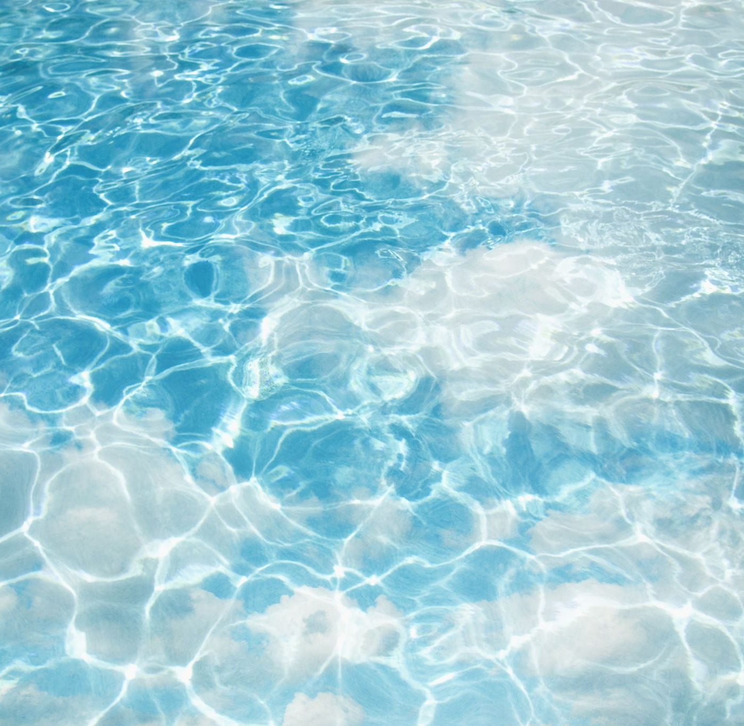
Water problems in Croatia

Slide 2
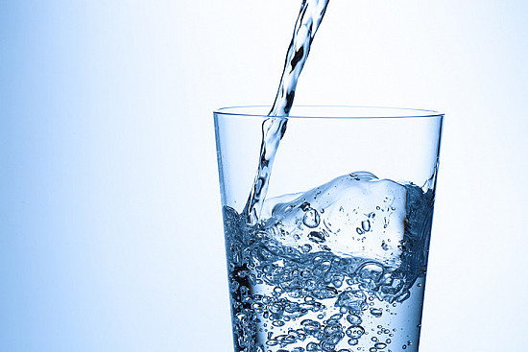
As it is known, Croatia has no problems with drinking water (so far)
Croatia has average of 27,330 cubic meters of fresh water per capita, which puts us in the first place in EU

Slide 3
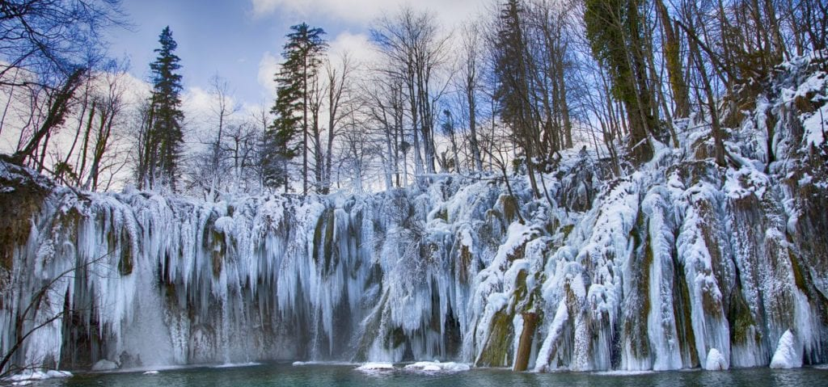
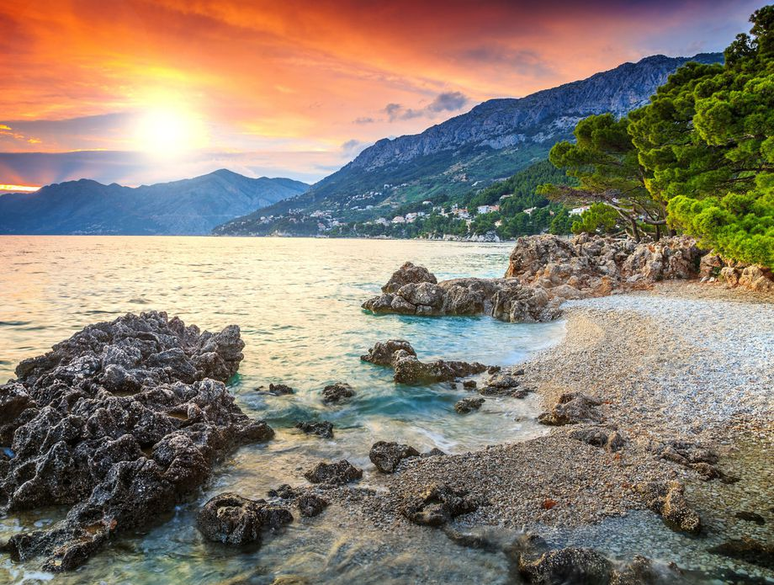
Climate in Croatia
In Croatia we have cold winters with lots of rain and some snow and summers are sunny, warm and dry

Slide 4
WATER PROBLEMS
Because of global warming every year we have more and more problems with floods, droughts, heavy rains and frost
In last year we had 80 million euros damage in agriculture because of floods and droughts

Slide 5
PROBLEM SOLUTIONS
Currently we don’t have any efficient solutions,
but we have some ideas to build accumulation lakes from flooded rivers that will be used for storing extra water in the time of droughts (now we irrigate only 1.5% of fields in Croatia)
That kind of lakes can be used as hydro power plant (renewable energy source) and for tourism

Slide 6
OUR SOLUTIONS
With the extra water one part of the water can be used for animals, watering plants and the rest can be stored in water towers and used for agriculture in the summer if there is a drought

