Slide 1
Reduce, reuse, recycle in our school & local comunity
Comenius project: Three is the magic number –
reduce, reuse, recycle
Osnovna škola Glina, Glina, Croatia
February, 2013.

Slide 2
International Eco school
In 2006 our school was declared international Eco school.
In the past seven years our students learned about and took good care of the environment.

Slide 3
We collect waste paper in our school. Students made „ ​​ŽIRKO PAPIRKO“ from the collected paper. They use it to dispose waste paper in it.

Slide 4
Žirko Papirko as a carnival mask
On the carnival day students used „Žirko Papirko“ as a carnival mask.
So he briefly changed his role and went to carnival parade.
On the day of the carnival students made ​​mask from „ Žirko Papirko“.

Slide 5
Return to school
It stands in a classroom and is used for disposing waste paper.
After the carnival „ŽIRKO PAPIRKO” returned to his original role.

Slide 6
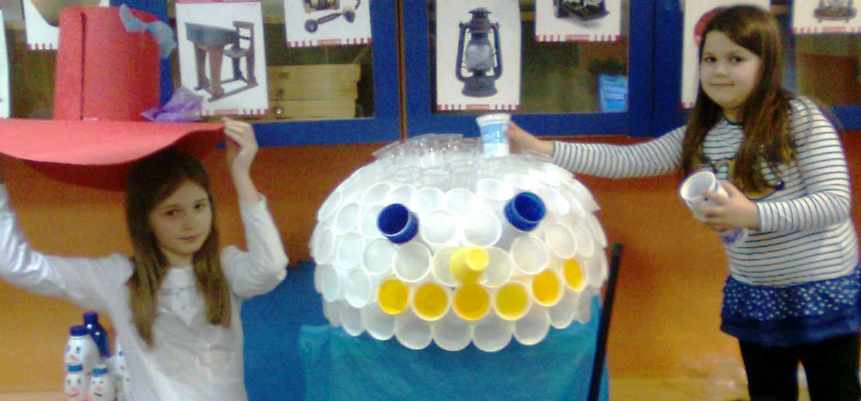
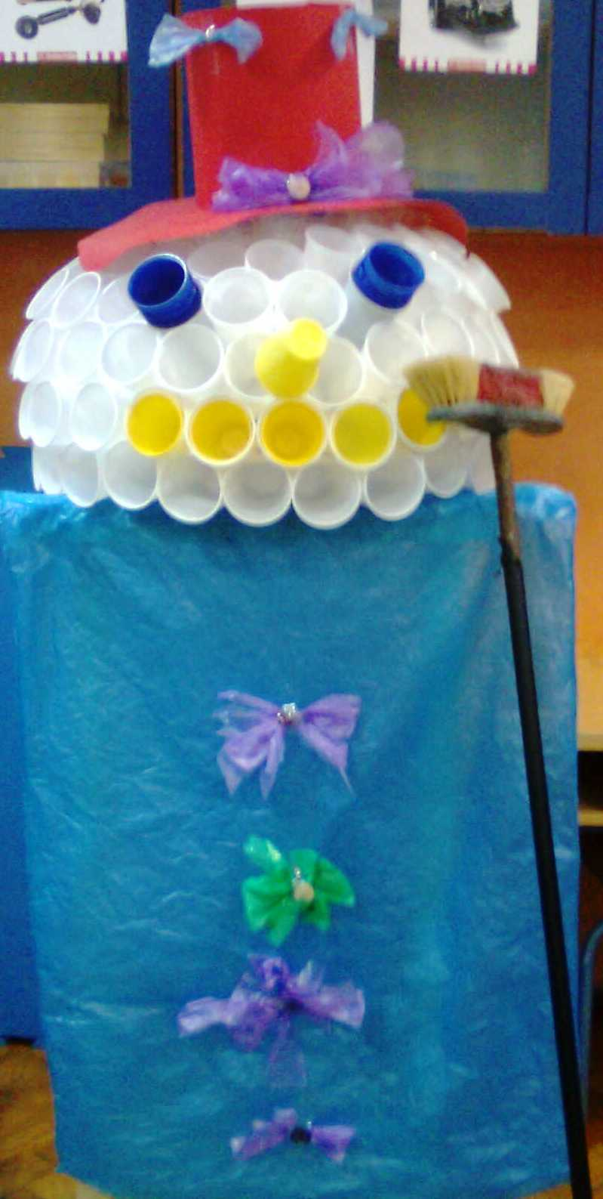
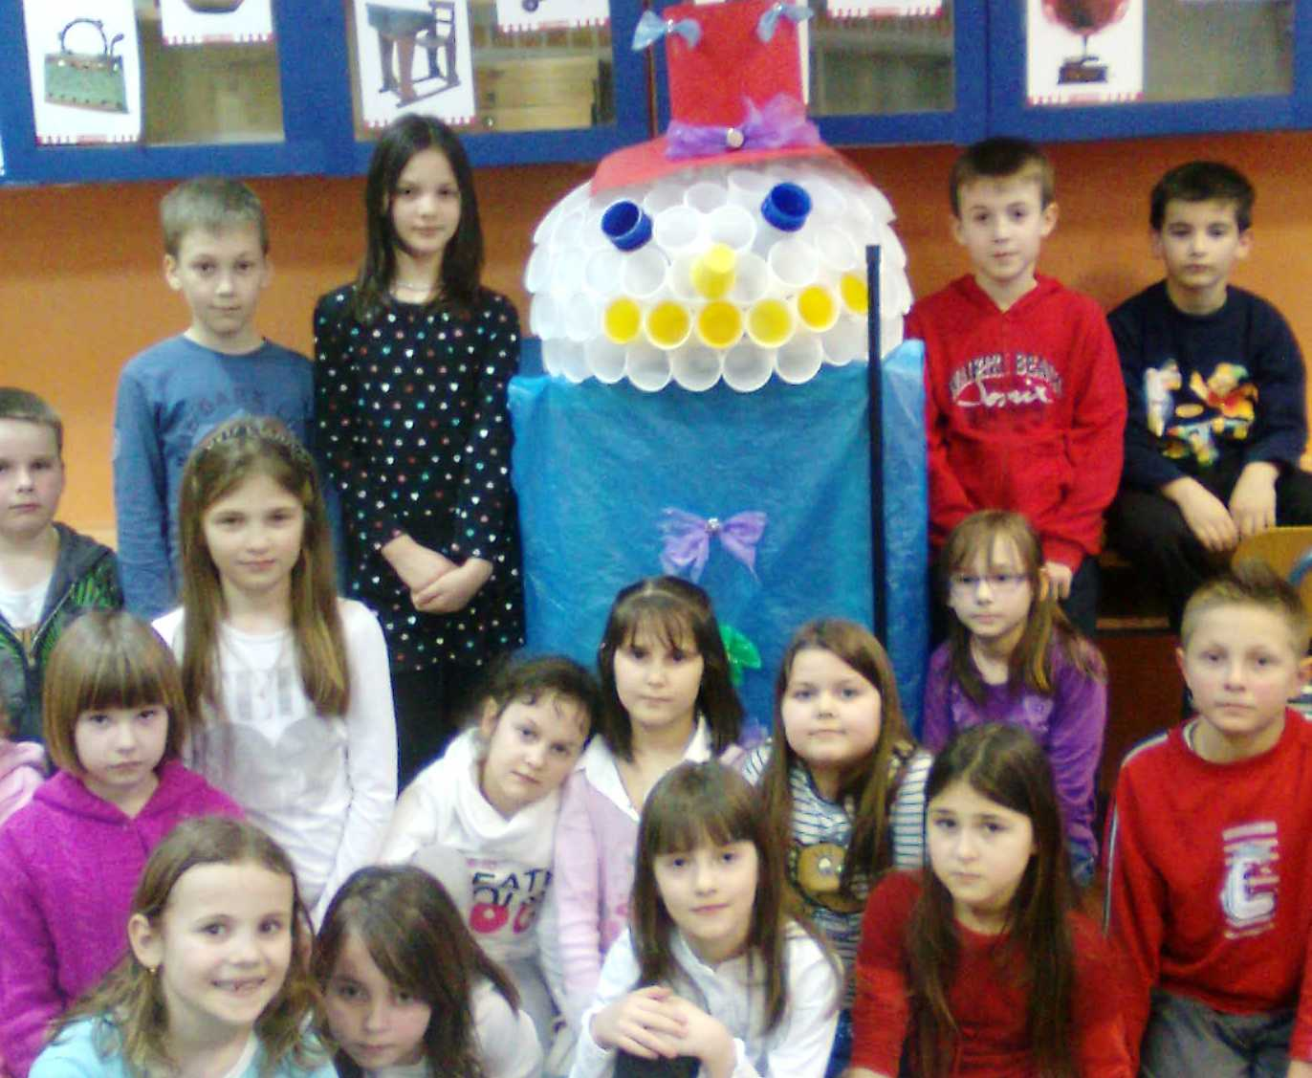
This is Snowpax.
He is our friend.
We put plastic waste in it.

Slide 7
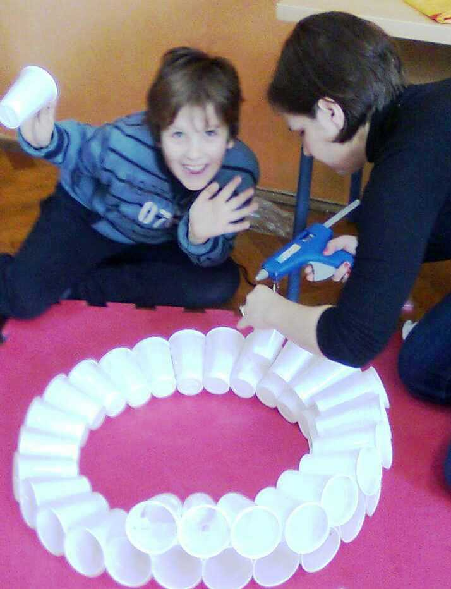
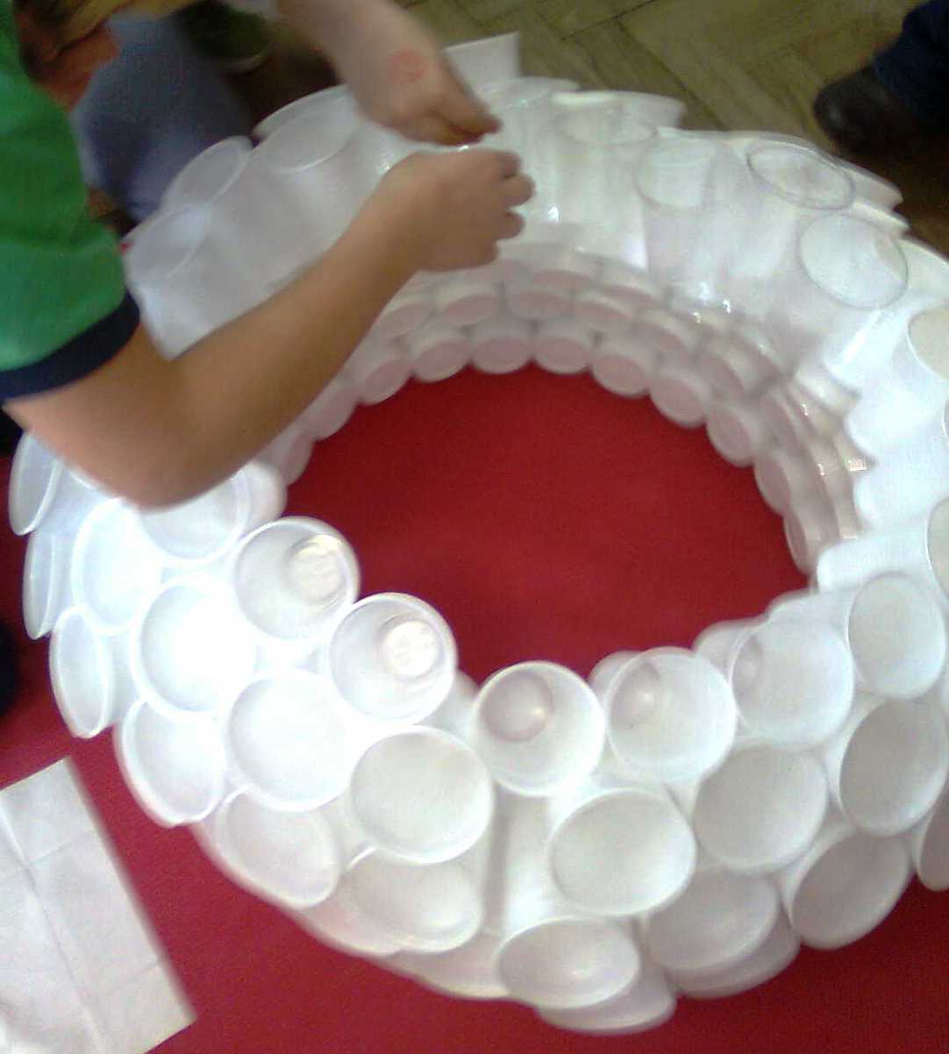
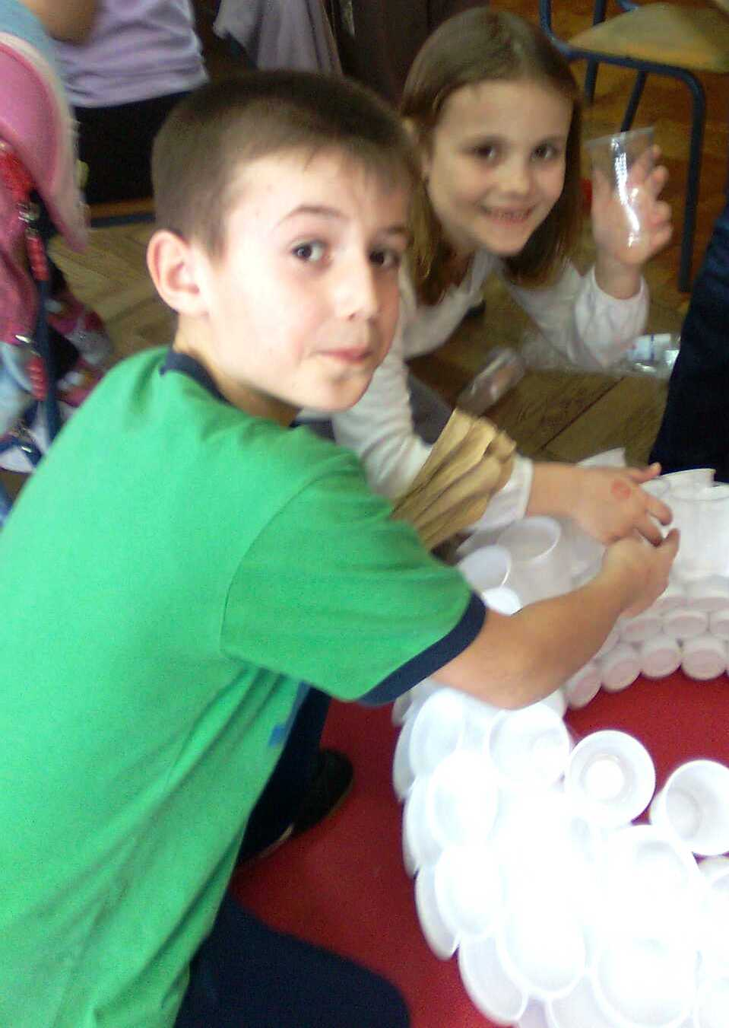
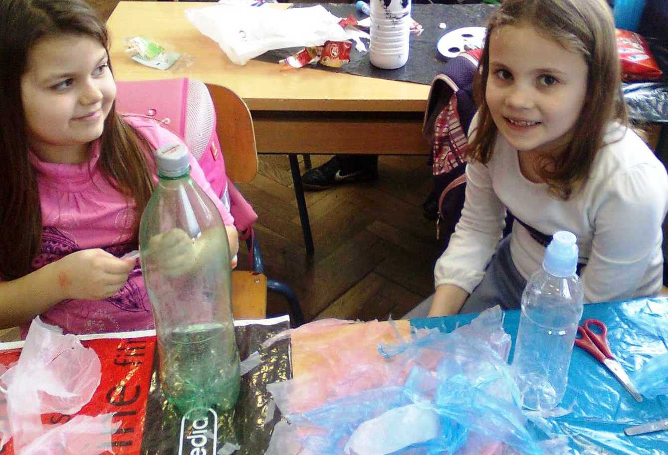
We made Snowpax with a help from our teacher and had a lot of fun.

Slide 8
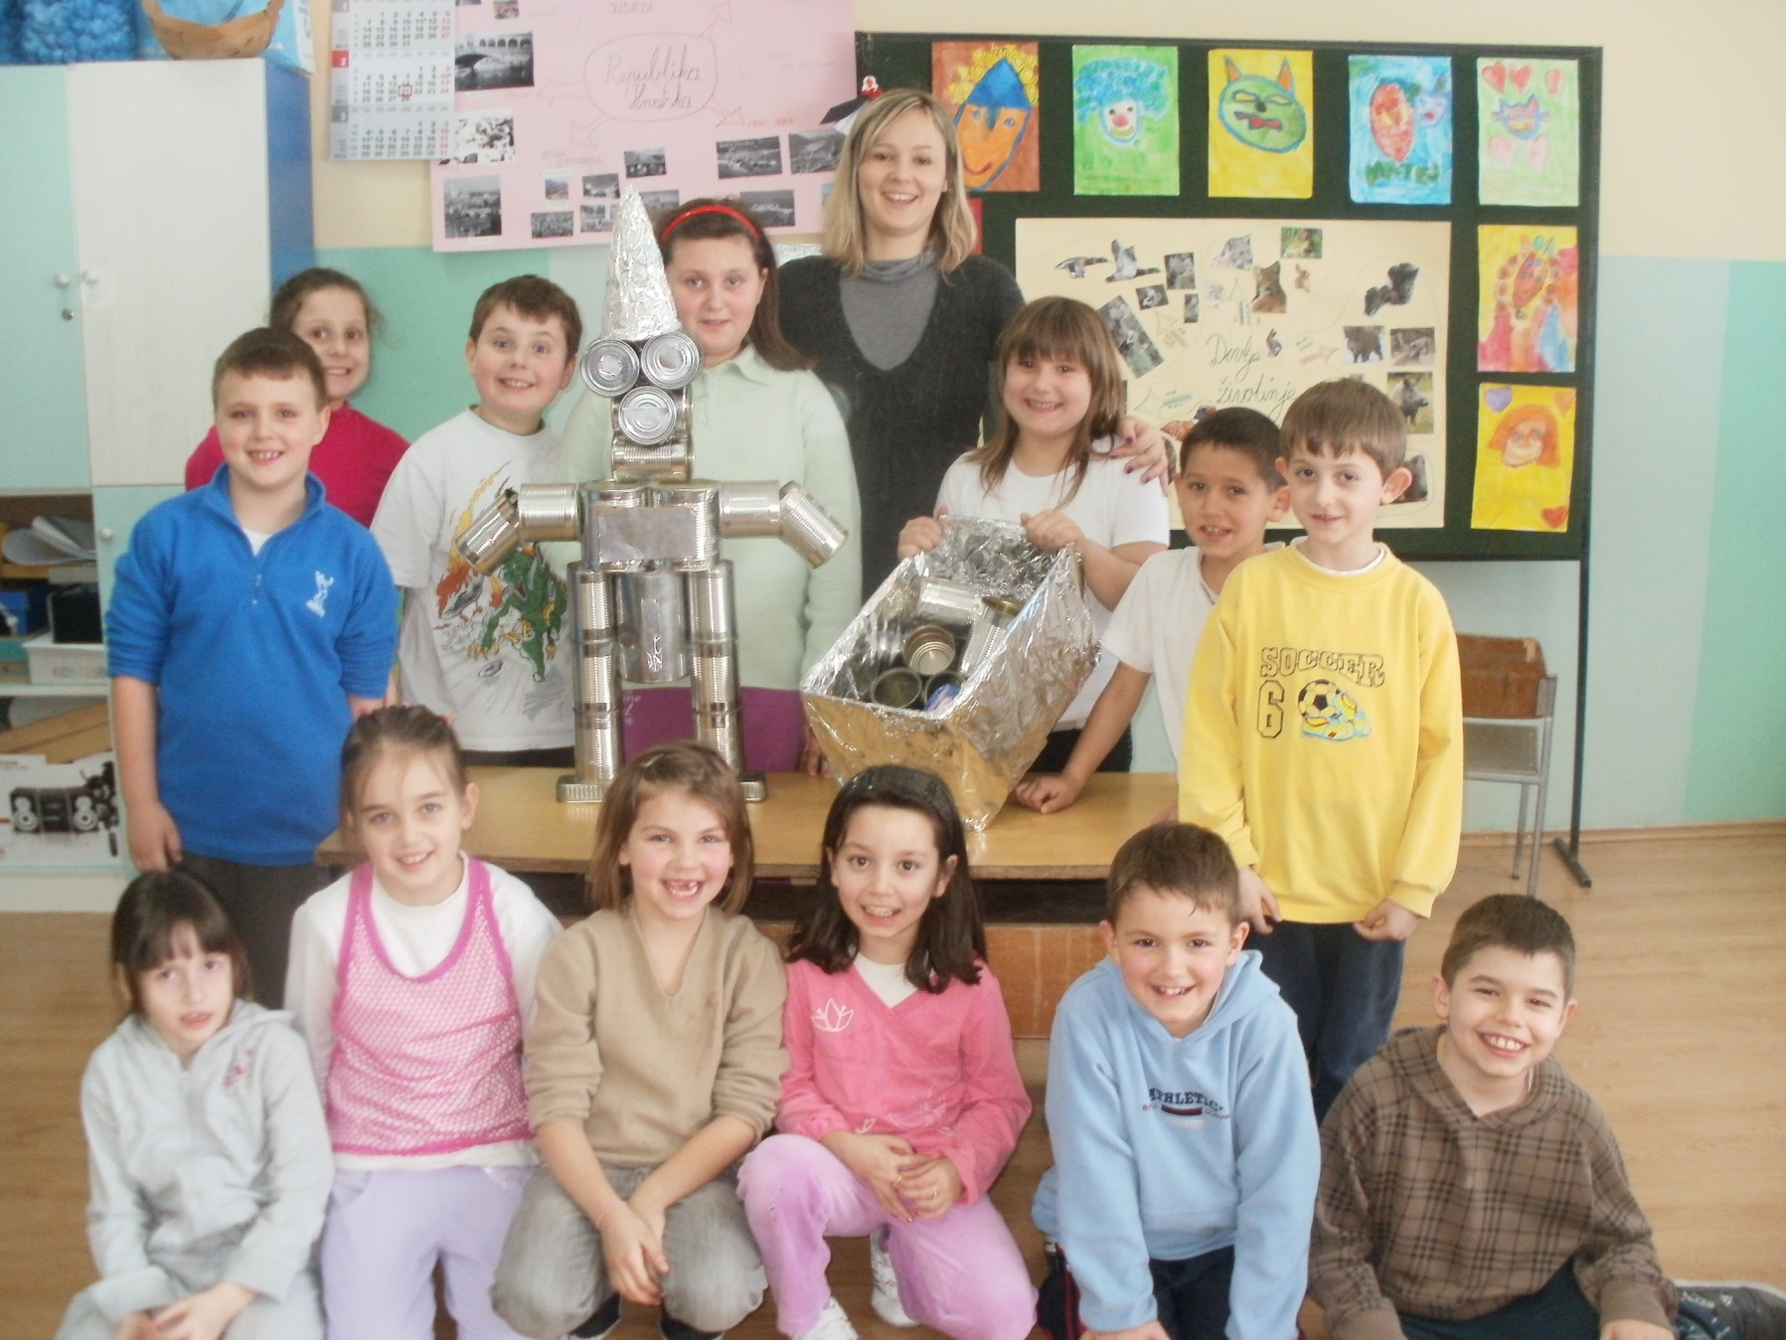
Also we collect metal waste in our school
with a little help from our friend.

Slide 9
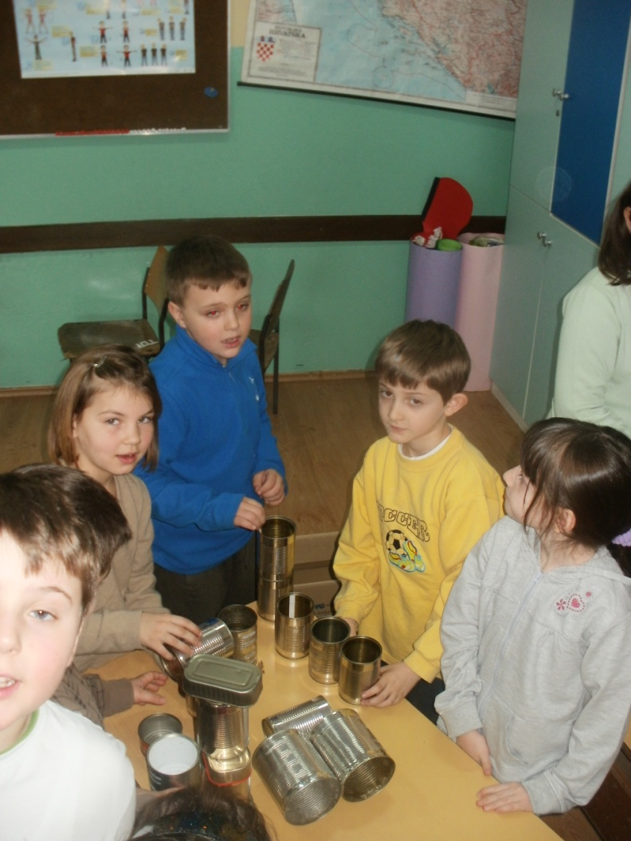
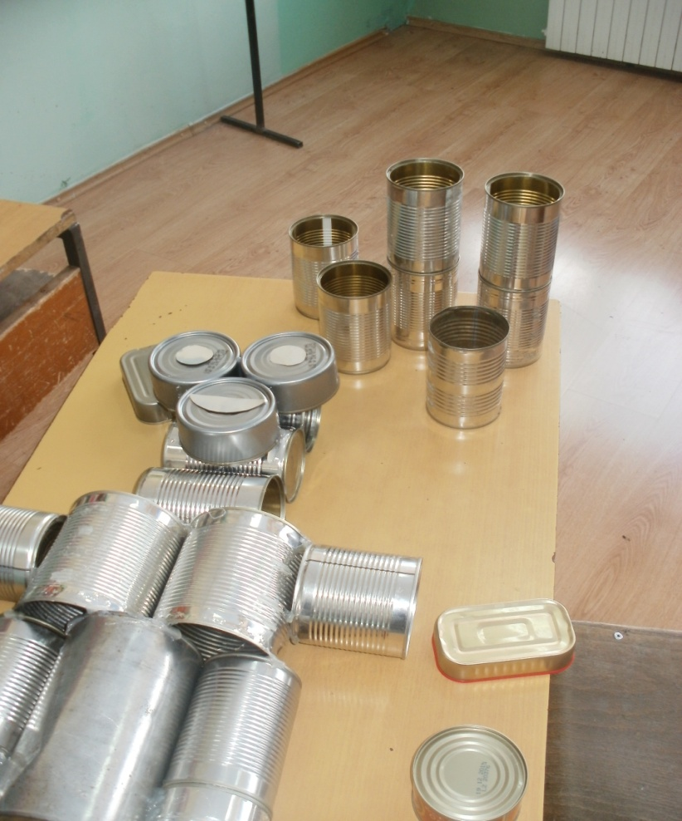
THE CANMAN
We collected wasted cans.
We selected cans for our Canman.

Slide 10
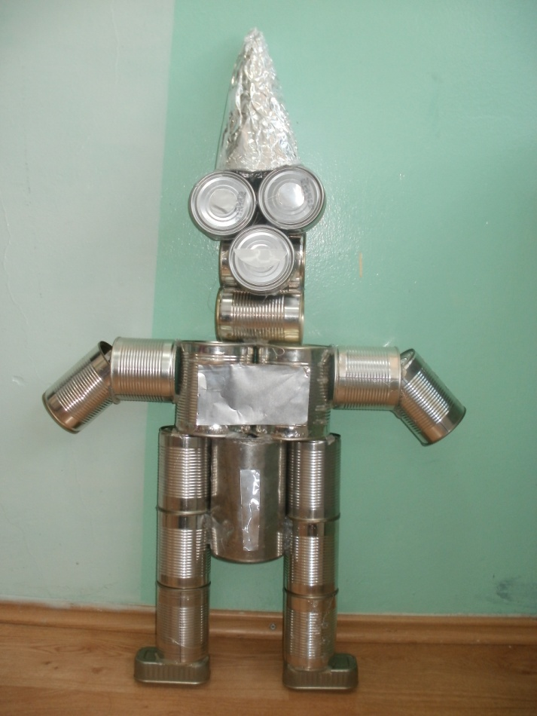
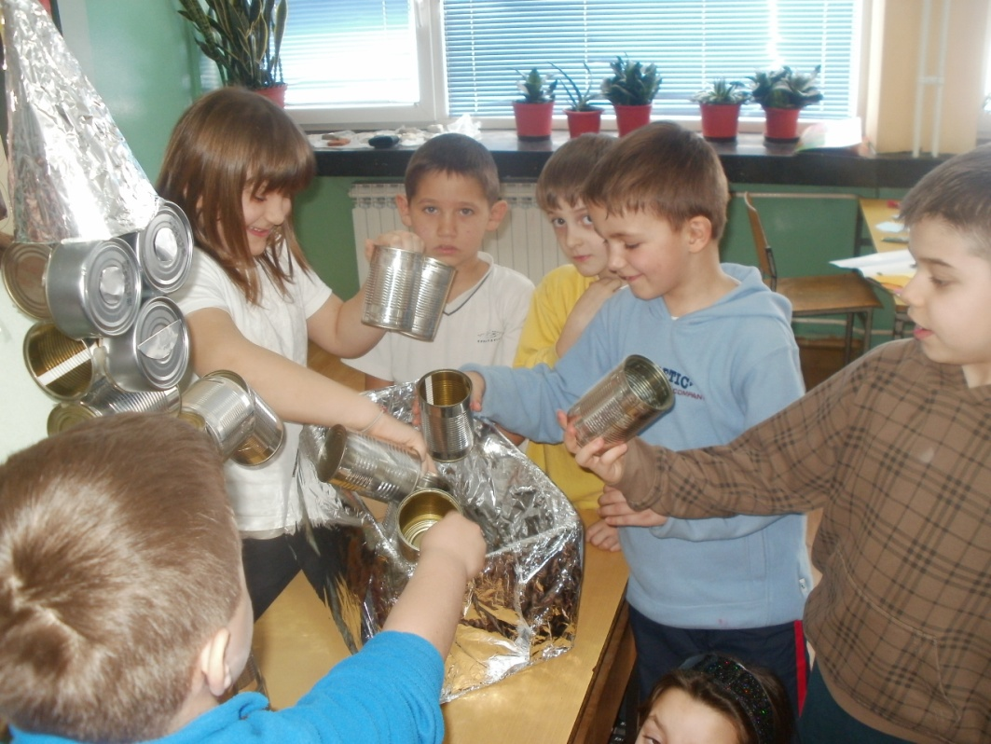
We did a class friend, CANMAN - Limenko
Our Canman
Now we classify the waste
with his help.

Slide 11
Every bigger town in Croatia has a place for collecting and sorting all types of waste. We call them recycling yards or green islands.

Slide 12
Students visited one of the green islands. A worker at the recycling yard explained the importance of collecting and sorting waste for the environment.

Slide 13
Diona – local supermarket
Diona is a big supermarket chain.
In Glina we have two supermarkets.
They repurchase old plastic & glass bottles, cans, etc.
Also they collect old cardboard.

Slide 14
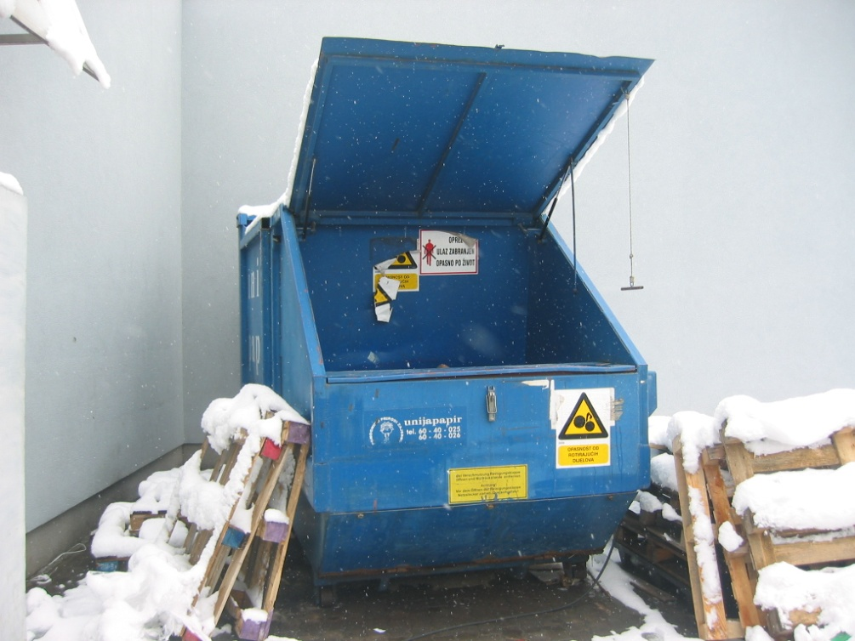
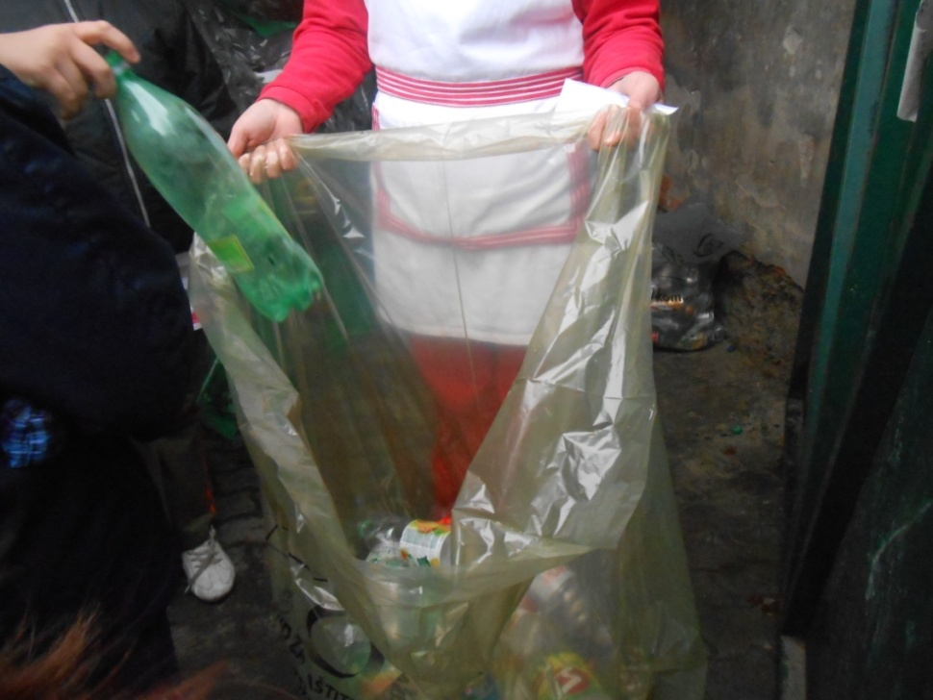
In every supermarket in Croatia, as Diona , people bring plastic or glass bottles and aluminum cans and they get 7 cents for each bottle or can.
In front of the supermarket there is a press for collecting old and used cardboard and paper.

Slide 15
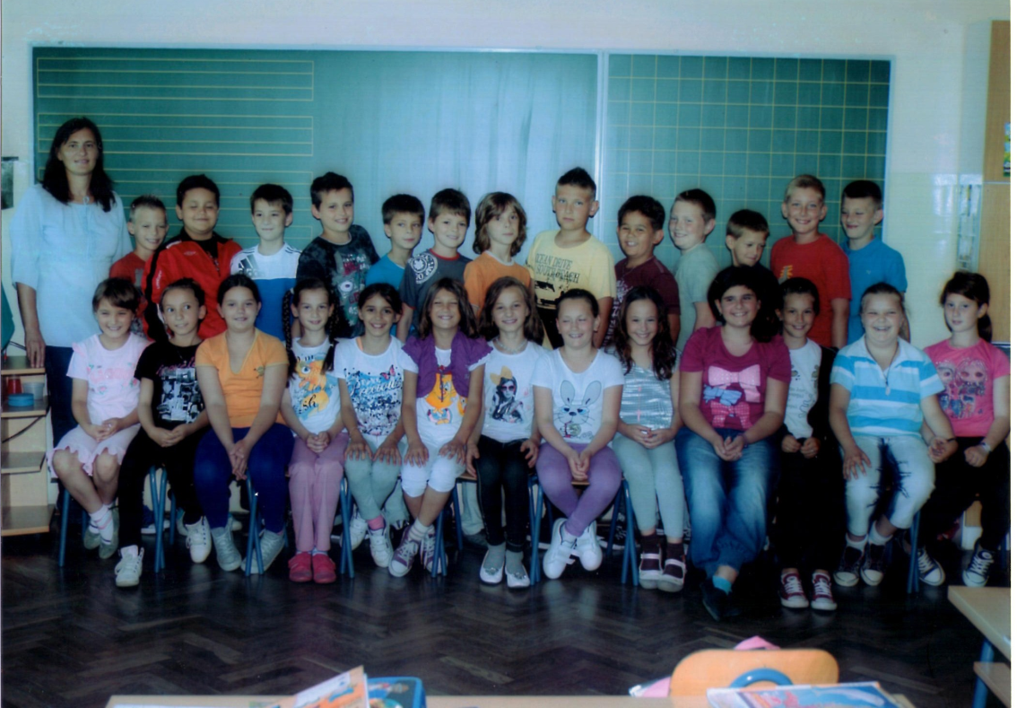
In Glina we have a company called Ferosirovina.
We visited the company and learned a few things.

Slide 16
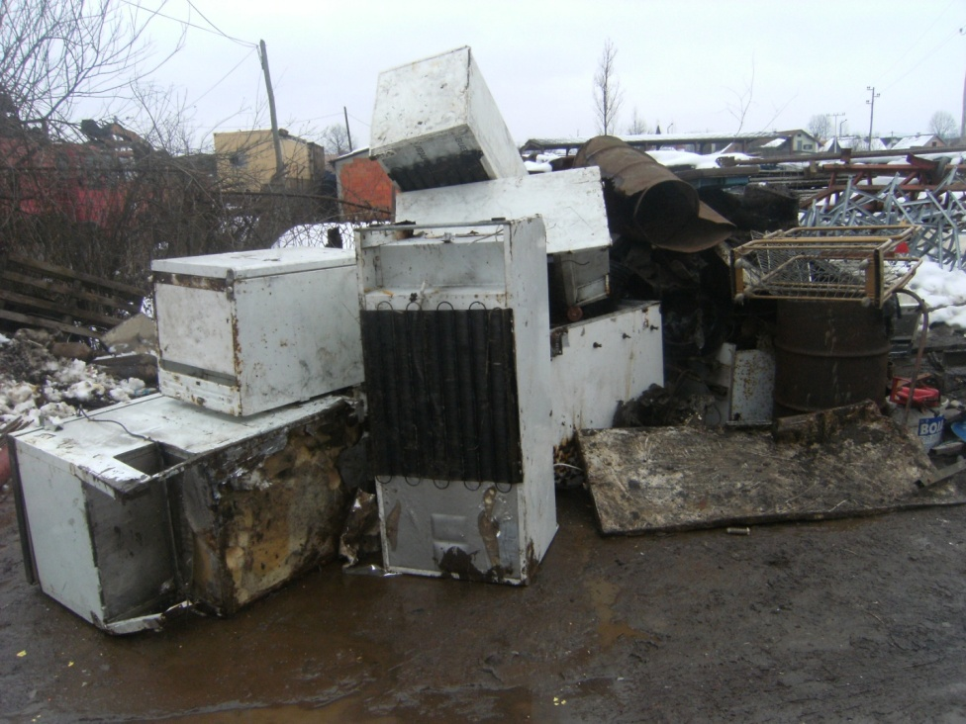
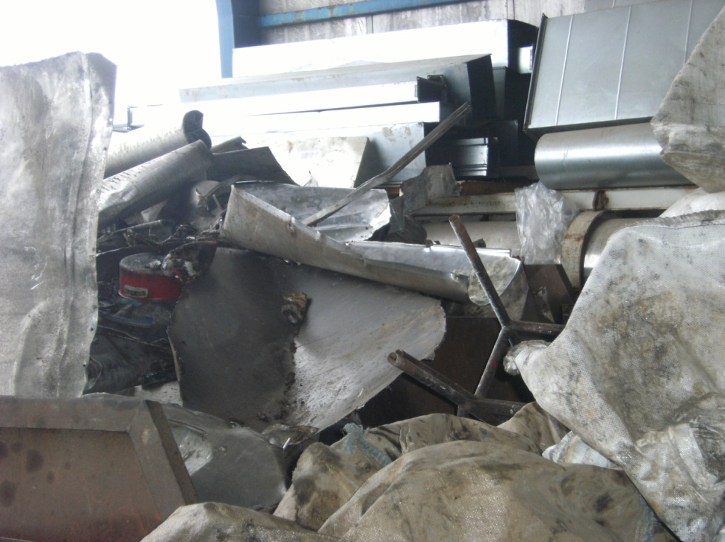
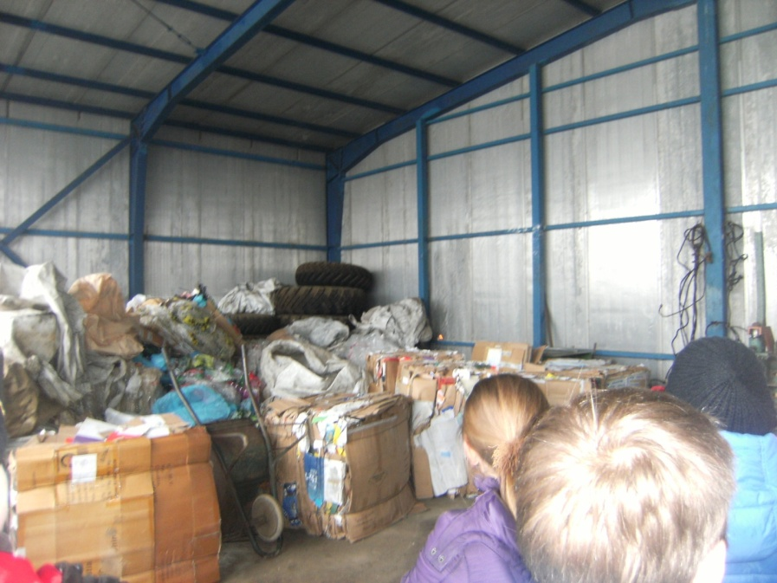
They collect all sort
of waste.

Slide 17
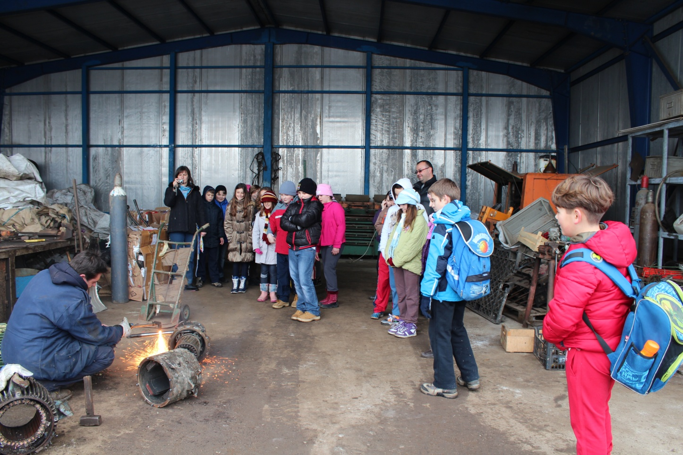
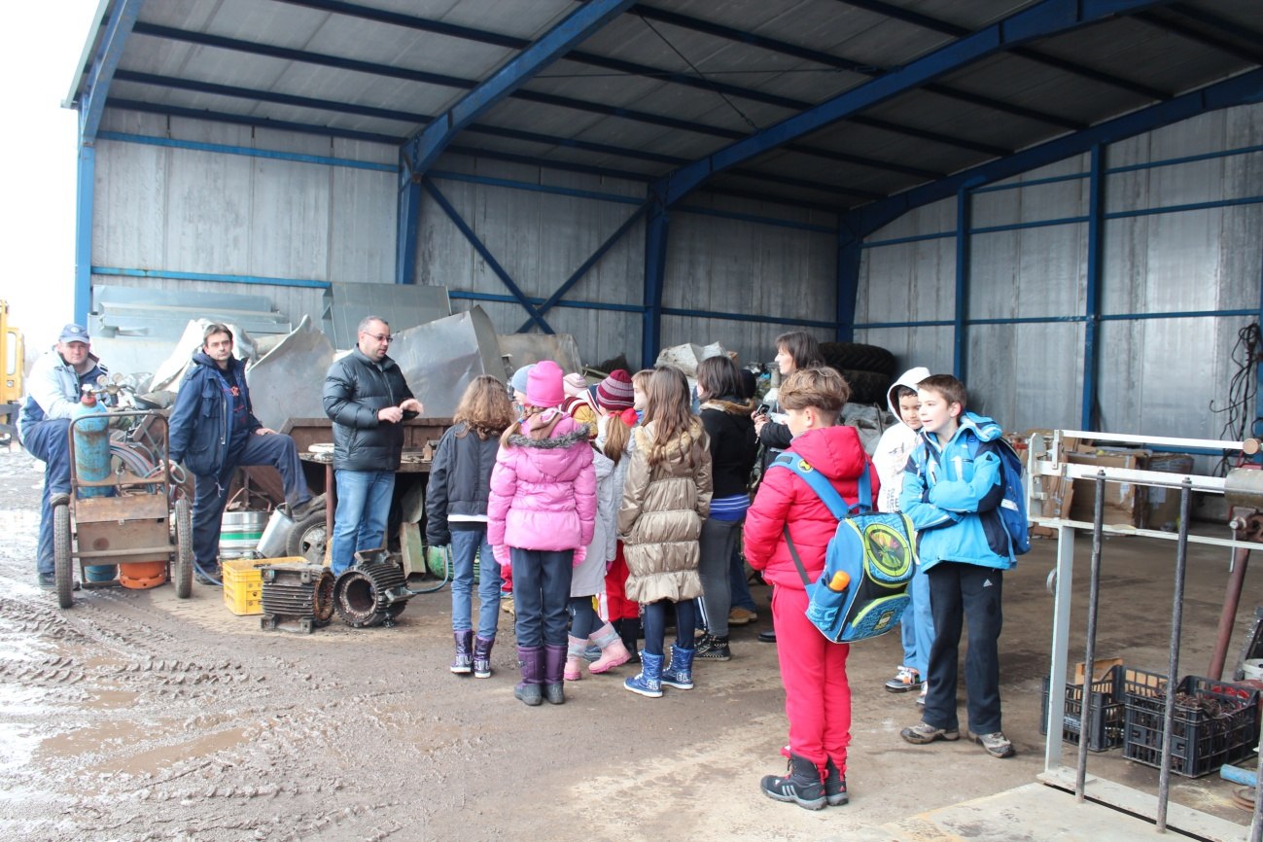
Mister Igor has shown and explained us how to collect and sort waste.
We have seen different iron objects - old cars, electromotors, house appliances, aluminium plates, old paper and tires.
We found out how to gather, sort and transport waste to fabrics where they process them to
new products.

Slide 18
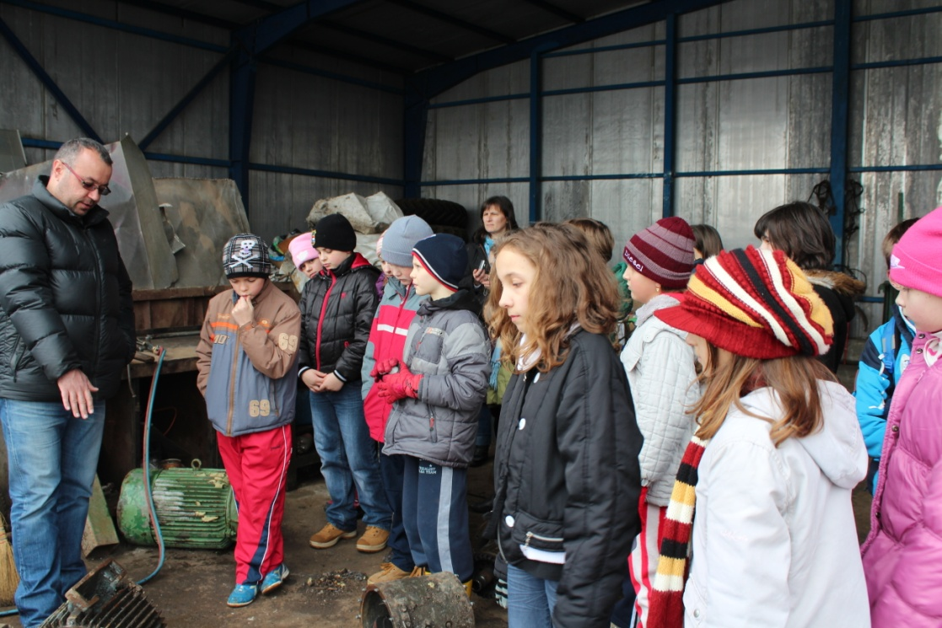
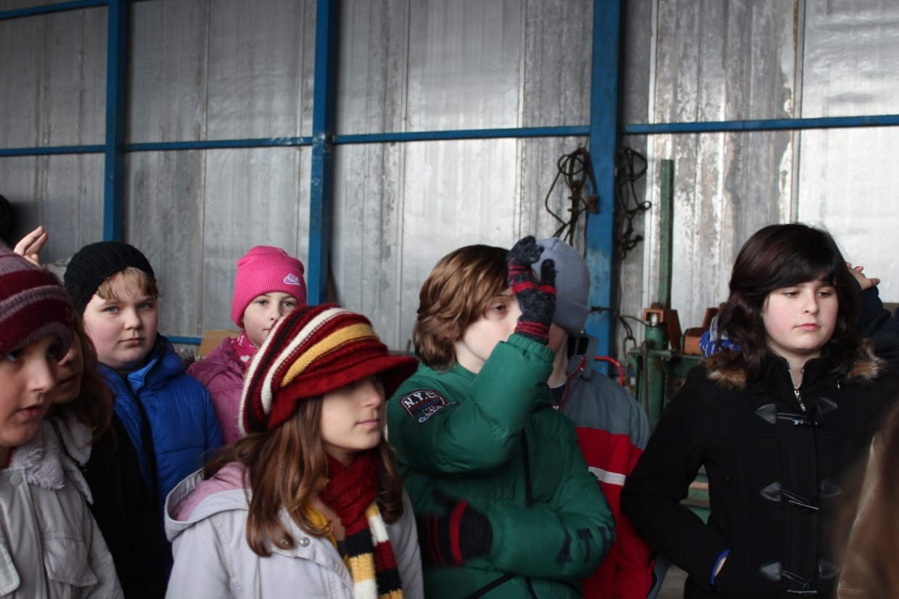
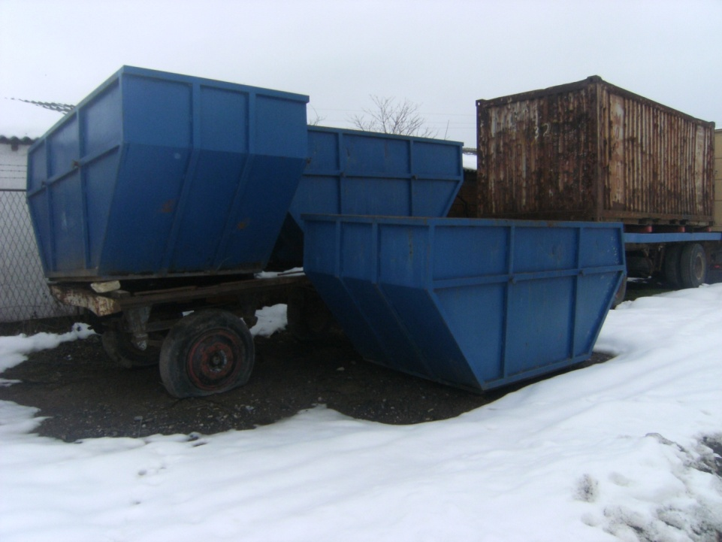
We learned that by collecting and processing waste we can save some money and take extra care of our environment.

Slide 19
Students visited one of the biggest glass factories in Central Europe - VETROPACK. Students were introduced with the entire production process of making glass by the comapny technical manager.

Slide 20
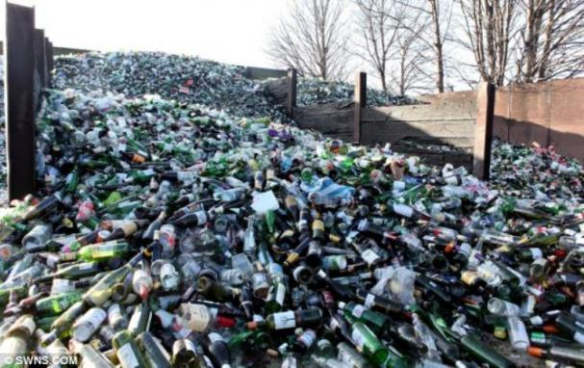
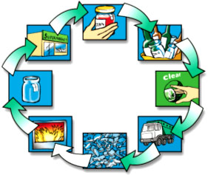
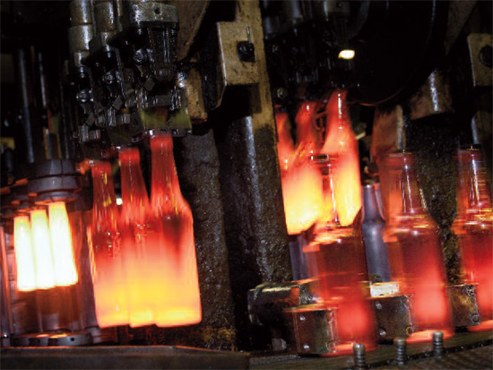
First they grind the old glass, then they melt it and in the end make new products.

Slide 21
Thank you for your attention!

Slide 22
Croatian Comenius team

